Slide 1
City of Bartow Fiscal Year 2025-2026 Proposed Budget Presentation
City Commission Budget Workshop July 17-18, 2025

Slide 2
Agenda July 17, 2025
Budget Overview
General Fund Overview
Department Presentations
Personnel Services
Capital Improvement Program
City Manager’s Office
Code Compliance and Neighborhood Services
Finance Department
Human Resources
Information Technology
Parks, Recreation and Cultural Arts
Golf Course
Library
Parks and Recreation
Planning
Police
FY 2025-2026 Proposed Budget
City Clerk’s Office
Total Budget
Funds | Revenues | Expenditures
Public Works – General Fund Portion
FY 2025-2026 Proposed
Budget Introduction
Welcome
Mike Herr City Manager
About the FY25-26 Budget Process Tracy Miller
Assistant City Manager
Investing Today for Bartow’s Tomorrow

Slide 3
Agenda July 18, 2025
Enterprise Funds
Internal Service Funds
Department Presentations
Electric
Department Presentations
Fiber Optic
Public Works
Solid Waste
Stormwater
Fleet Management
Utilities
Wastewater
Water
Special Revenue Funds
Department Presentations
Building
CRA
Fire Services
Public Works
Transportation
Capital Replacement Fund
Underground Utilities TCS
Investing Today for Bartow’s Tomorrow

Slide 4
City of Bartow | Demographics
Form of Government: Commission-Manager
City Manager: Robert Michael Herr
Incorporated: 1851
Population: 22,084
City of Bartow Combined Property Value (Assessed Value): $1,554,629,533
Parks: 17
Recreation Centers: 3
Library: 1
Square Miles: 46.34
CRA Square Miles: 2.464
Number of Schools K-12: 4

Slide 5
City of Bartow | Utility Demographics
Utility Service Area:
Utility Services
Electric
Solid Waste
Wastewater
Water
Utility Customers | As of May 31st 2025
Electric
Electric Inside City Limits | 9,736
Electric Outside City Limits | 3,774
Total of Electric Customers | 13,510
Solid Waste
Solid Waste Residential | 7,479
Rollout Carts | 171
Dumpsters & Compactors | 643
Total Solid Waste Customers | 8,293
Waste Water
Sewer I/S Total | 8,302
Sewer O/S Total | 1,151
Multi Family / Master Meter | 53
Total of All Sewer Customers | 9,506
Water
Water I/S Total | 8,813
Water O/S Total | 1,730
Total of All Water Customers | 10,543

Slide 6
City of Bartow | Organizational Demographics
Total FTE: 377 | 352 Full Time 50 Part Time
Number of Departments: 15
13 new positions as described in the Workforce section of this letter including:
2 Split Funded Positions
1 City Engineer
1 W/WW Mechanic
4 Electric Utility Employees
3 Fire Services Employees
1 Solid Waste Employees
3 Wastewater Employees

Slide 7
City of Bartow | Major Accomplishments
Preparation of the Employer of Choice Initiative and the three pillars
Launch of Bright Ideas Program
Establishing a Wellness Program
Health Care Stipend
Revamp the Budget
Maximizing outside funding opportunities using state and federal appropriations as well as state and federal grants
Develop the City of Bartow Strategy and Performance Dashboard
Red Light Camera Program Active
Eliminated 4 drug houses
Conducted 2 Capital City Clean-Up programs in Zone F and Zone E
6 Lift Station Improvements
Installed Standby Generator at Wastewater Treatment Plan and 15 Lift Stations

Slide 8
City of Bartow | New Technology
Implement Agenda Management System
Deploy Recruitment module in HRMS
Develop Sandbox for Asset Management System
Launch Citizen Complaint Tracking System
Improve Sound System at Civic Center
Establish a mobile ready audio/visual platform for live streaming of community events
Utilize SmartSheet to improve our ability to efficiently and effectively make databases to support large scale initiatives like the Employer of Choice and the Budget
Fully Utilize OpenGov for preparation of FY25-26 Budget
Continued improvements to the City’s GIS platform

Slide 9
City of Bartow | Best Practices and Innovation
Development of a modern employee manual
Combine the use of a broadband system with a step plan to make a career ladder program
Use of Hot Box Trailer for road patching
Update to Uniform Design Standards
Improvements to Customer Service: new performance measures, phone tree, technology and after hours call taking
Smart Covers for Manholes | Part of Manhole R&R Program
Accreditation in: Fleet, Dispatch, Police
Purchasing Laptop computers on a lease program and implement a four-year replacement program which will make our workforce more mobile ready
Purchase of Solid Waste and Fire vehicles on lease programs to ease large-scale capital expenditures
Use of Urban SKD Traffic Application to monitor traffic and speeding

Slide 10
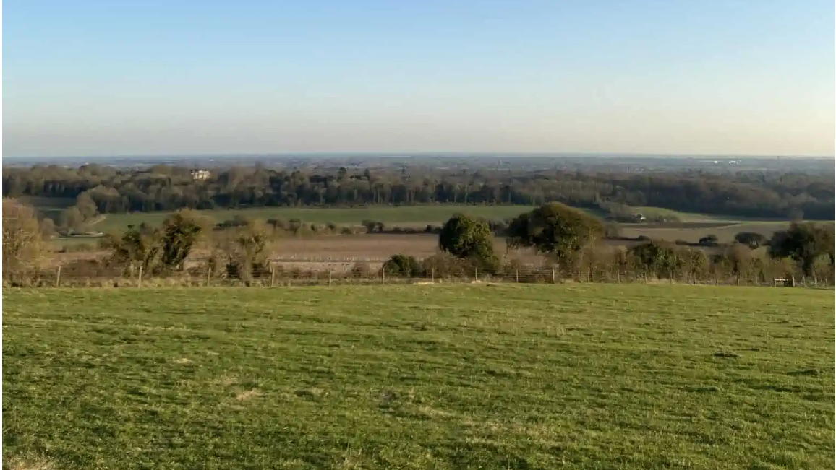
City of Bartow On the Horizon
City-wide Strategic Planning Process
Master Planning in Parks, Recreation and Cultural Arts, Water, Wastewater, and Fiber Optics
Assessment of AMI Technology for Utilities
24X7 Call Center for Customer Service
Downtown Redevelopment Opportunities
Seeking the GFOA Distinguished Budget Award
Development of Additional Key Performance Measures
Implementation of Platform Technology in Human Resources, Finance, Utility Billing, Procurement, Epermitting, Asset Management, Customer Communication

Slide 11
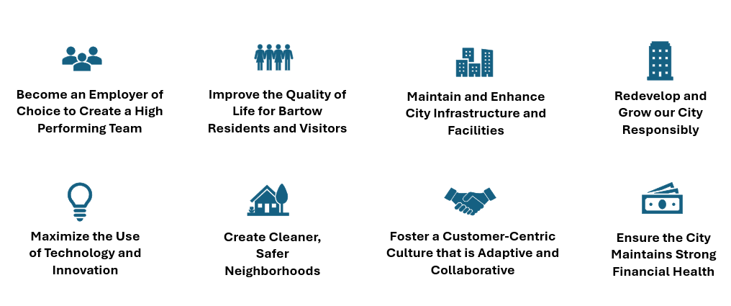
Strategic Planning | City Goals

Slide 12

Strategic Planning and Performance Dashboard
Aligning City-wide vision, mission and goals to department goals, measures and initiatives
Monthly key performance measures tracking
Monthly strategic initiative tracking
Public reporting on strategic activities
Support for budget preparation

Slide 13
About the Budget Book
Move Toward a Program Budget
Better describes our financial activities in a way that improves transparency
New Funds Established
Integration of all Impact Fee Fund categories within both our revenue and expenditure framework
Establishment of a Building Fund, classified as a Special Revenue Fund
Creation of a Fleet Management Internal Service Fund and Capital Replacement Fund
Formation of an Employee Benefits Internal Service Fund
Strategy and Performance Reports
Includes reporting on mission, vision, summary of services, goals, initiatives and performance measures at the department level
Formalized Capital Improvement Plan FY25-26 to FY30-31
Inclusion of CIP Detail Sheets for Each Project in the CIP regardless of year

Slide 14
Key Definitions
Charges for Service – Revenue derived from charging fees for providing certain government services. These revenues can be received from private individuals or entities, or other governmental units.
Enterprise Fund – Activities of government that are operated and accounted for as businesses. Enterprises rely principally on revenue derived from user fees to fund operations.
Impact Fee – A fee imposed on new development as a total or partial reimbursement for the cost of additional facilities made necessary by the growth.
Interfund Transfer – Transfer of resources from one fund to another fund in the same governmental entity. Transfers are not repayable and do not constitute payment or reimbursement of goods provided or services performed.
Internal Service Fund – A type of fund designed to account for the financing of goods, or services provided by one department for other departments within the city. Goods and services furnished are billed at cost plus an overhead factor designed to cover the indirect expenses of the fund.
Special Revenue Fund – A fund to account for revenue derived from specific sources that are restricted by law or policy to finance specific activities.

Slide 15
Proposed Budget Overview Fiscal Year 2025-2026

Slide 16
Budget Overview
Proposed Millage Rate | 6.1080
15.28% increase in Ad Valorem taxes
Total Assessed Value: $1,554,629,533
Funding for the Implementation of the Employer of Choice Initiative for all positions
Revisions to Enterprise Contributions from Electric, Water and Wastewater to the City
Development of a New Allocation Matrix to Attribute Costs More Accurately
Updated Revenue Projections of the City’s Recently Revised User Fees and Impact Fees
Continued Capital Improvement Plan Spend Down Plan of Key Projects:
Pool and Aquatics Center: $3.5M
Joint Fire Station 2: $5.2M
Public Works Administration: $2.5M
Non-profit organization and Community Partner Funding: $309,400

Slide 17

City of Bartow Total Budget
Total Fiscal Year 2025-2026 Proposed Budget | $135,934,528
Reflects operating and capital expenditure budgets combined excluding transfers

Slide 20
Major Funds Budget Projections
Fund | FY 2024-2025 Adopted | FY 2025-2026 Proposed | Difference
General Fund
Revenues | $28,967,426 | $38,341,575 | $9,699,985
Expenditures | $40,078,143 | $40,203,112 | $124,969
Electric Department Enterprise Fund
Revenues | $38,752,486 | $39,450,691 | $698,205
Expenditures | $47,525,413 | $39,450,691 | ($8,074,722)
Fiber Optic Enterprise Fund
Revenues | $136,643 | $566,333 | $429,690
Expenditures | $653,734 | $566,333 | ($87,401)
Solid Waste Enterprise Fund
Revenues | $6,632,128 | $6,481,675 | ($150,453)
Expenditures | $7,396,391 | $6,481,675 | ($914,716)
Notes:
Notes for Mike

Slide 21
Major Funds Budget Projections
Fund | FY 2024-2025 Adopted | FY 2025-2026 Proposed | Difference
Stormwater Utility Enterprise Fund
Revenues | $3,411,891 | $3,502,267 | $90,678
Expenditures | $4,037,794 | $2,286,210 | ($1,751,584)
Water Enterprise Fund
Revenues | $14,129,857 | $14,851,569 | $721,712
Expenditures | $17,406,232 | $10,308,609 | ($7,097,623)
Wastewater Enterprise Fund
Revenues | $14,021,169 | $14,220,303 | $199,134
Expenditures | $18,308,983 | $10,291,622 | ($8,867,361)
Employee Benefits Internal Service Fund
Revenues | N/A | $322,918 | Fund Established in 2025
Expenditures | N/A | $322,918 | Fund Established in 2025
Notes:
Notes for Mike

Slide 22
Major Funds Budget Projections
Fund | FY 2024-2025 Adopted | FY 2025-2026 Proposed | Difference
Fleet Maintenance Internal Service Fund
Revenues | N/A | $2,101,544 | Fund Established in 2025
Expenditures | $2,274,532 | $2,433,683 | $159,151
Fire Impact Fee Fund
Revenues | N/A | $343,600 | Fund Established in 2025
Expenditures | N/A | $0 | Fund Established in 2025
Police Impact Fee Fund
Revenues | N/A | $379,600 | Fund Established in 2025
Expenditures | N/A | $0 | Fund Established in 2025
Notes:
Notes for Mike

Slide 23
Major Funds Budget Projections
Fund | FY 2024-2025 Adopted | FY 2025-2026 Proposed | Difference
Public Facilities Impact Fee Fund
Revenues | N/A | $165,600 | Fund Established in 2025
Expenditures | N/A | $2,400,000 | Fund Established in 2025
Transportation Impact Fee Fund
Revenues | N/A | $422,400 | Fund Established in 2025
Expenditures | N/A | $0 | Fund Established in 2025
Water Impact Fee Fund
Revenues | N/A | $679,600 | Fund Established in 2025
Expenditures | N/A | $6,844,000 | Fund Established in 2025
Wastewater Impact Fee Fund
Revenues | N/A | $955,600 | Fund Established in 2025
Expenditures | N/A | $2,415,756 | Fund Established in 2025
Notes:
Notes for Mike

Slide 24
Major Funds Budget Projections
Fund | FY 2024-2025 Adopted | FY 2025-2026 Proposed | Difference
Building Special Revenue Fund (Licenses and Permits)
Revenues | $775,836 | $943,955 | $168,119
Expenditures | N/A | $1,451,933 | Fund Established in 2025
Community Redevelopment Agency Special Revenue Fund
Revenues | $4,062,083 | $8,830,108 | $4,768,025
Expenditures | $4,062,083 | $11,909,717 | $7,847,634
Fire Services Special Revenue Fund
Revenues | $5,128,169 | $7,046,201 | $1,918,032
Expenditures | $9,863,652 | $6,291,155 | ($3,572,497)
Transportation Special Revenue Fund
Revenues | $2,995,832 | $3,021,156 | $25,324
Expenditures | $2,593,157 | $3,021,156 | $427,999
Notes:
Notes for Mike

Slide 26
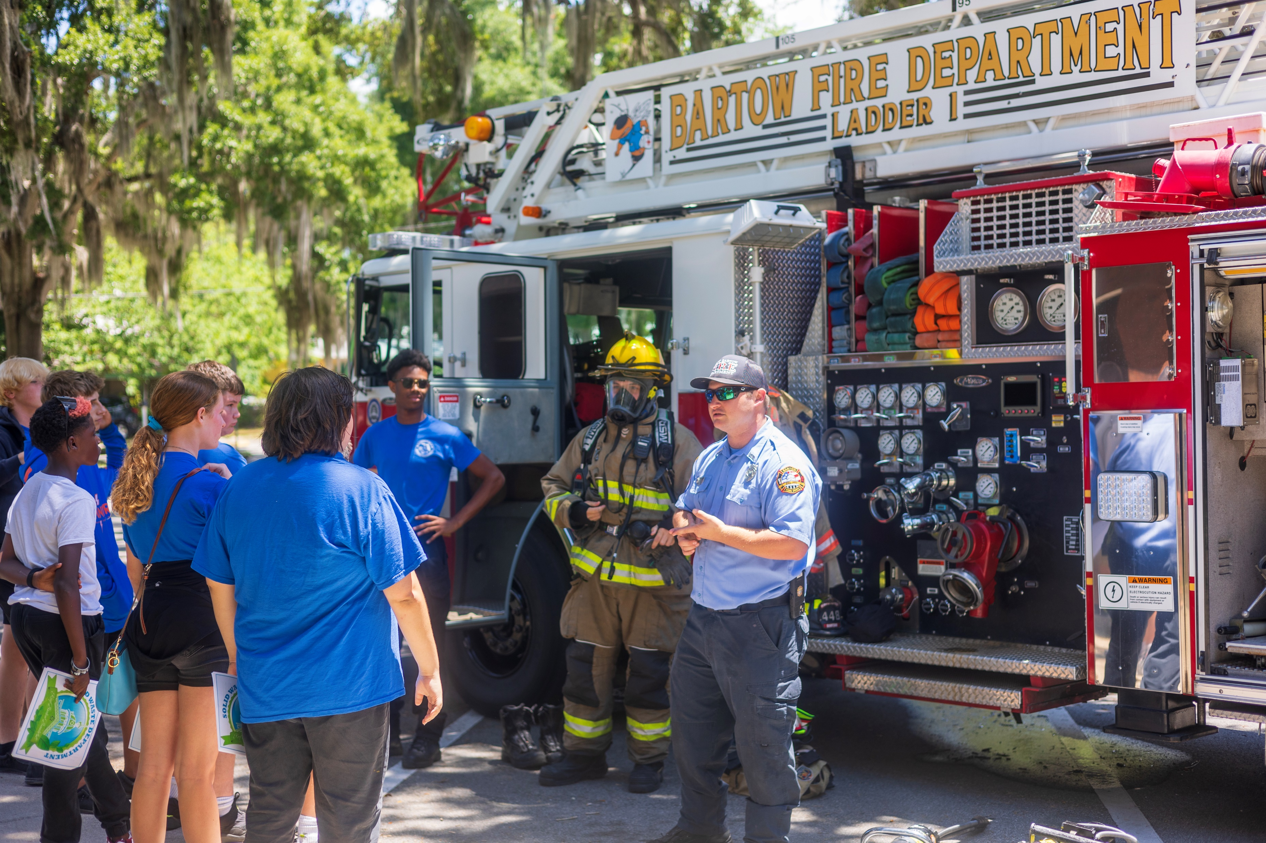
Bartow Personnel Statistics | FY 2025-2026 Proposed Budget
13.18% vacancy rate as of June 25, 2025
Total FTE count 377 (number as of 6/21/25)
352 full time staff members
Includes 7 Polk County Library Cooperative staff that are paid for in total by Polk County
50 part time positions
Notes:
Condense 15 and 16

Slide 27
13 New Positions in the FY25-26 Proposed Budget
Position | Department | Funding Source(s) | Benefit to Public
City Engineer | City Manager’s Office | Split Funded | The City Engineer is a key position to provide the technical expertise needed to evaluate infrastructure improvements. It will be funded from various funds.
Firefighter (3) | Fire Services | Fire Fund/General Fund | Necessary staff to gear up for multi-station Fire Services to include opening the Fire Station at the South East location
Apprentice Line Worker I | Electric | Electric Fund | Allows for the training for the next generation of electric employees.
Line Worker Journeyman | Electric | Electric Fund | Assists with providing seasoned service-ready staff in the field to operate Electric crews effectively
GIS Technician | Electric | Electric Fund | Creates the opportunity to better manage GIS mapping for the Electric Department as we move to the Cartegraph Asset Management environment

Slide 28
13 New Positions in the FY25-26 Proposed Budget
Position | Department | Funding Source(s) | Benefit to Public
Wastewater Plant Operator (3) | Utilities | Wastewater Fund | Improve service delivery by staffing operations 24 hours a day 7 days a week
W/WW Utilities Mechanic | Utilities | Wastewater Fund/Water Fund | Cross-trained staff member to work at the Wastewater and Water Plants in the maintenance unit

Slide 29

Employer of Choice Goals
Goal 1: Establish minimum pay at $15.00 per hour for all positions and provide competitive market pay throughout the system
Goal 2: Place the right people in the right seats on the bus and keep them on the journey
Goal 3: Develop and implement straightforward policy and practices that can be easily followed, monitored, and understood by our employees
Goal 4: Adopt a modern Human Resources philosophy that harnesses innovation and best practices
Goal 5: Create an efficient and effective holistic system that maximizes the use of technology for internal operations

Slide 30
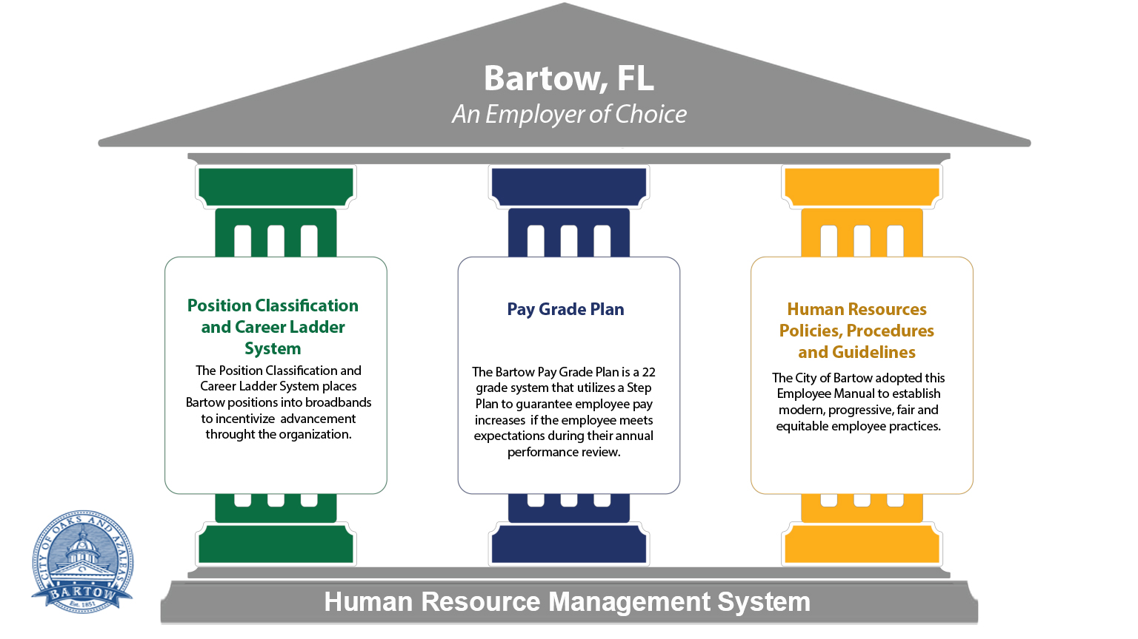
The Three Pillars of our Employer of Choice Initiative
Notes:
Position Classification and Career Ladder System and Pay Grade Plan Work Together to…
Facilitate employee advancement and provide a means for their professional growth and development
Define “roadmaps” for growth for Bartow’s employees that increase potential for attracting new talent and sustaining the talented human capital presently working for the City
Create greater compensation and benefits equity for employees relative to the local labor market

Slide 31

Implementation of the Market Rate Pay Plan

Slide 32
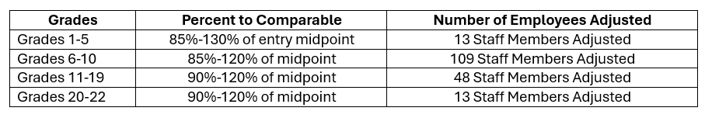
Implementation of Market Rate Study
Parameter 1: Adjust all employees to the midpoint based on the following breakdown

Slide 33
Implementation of Market Rate Study
Parameter 2: All staff must make a minimum of 2.75% increase in year one
Parameter 3: Hours adjusted on relevant positions
1560 hours used to determine all part time positions
2,496 hours used to determine all Firefighter/Fire Driver/Fire Lieutenant staff positions
Parameter 4: In an affected position class with multiple positions, adjustments were made across the class
Length of service adjustments were applied in brackets to the following positions: Firefighter, Fire Driver, Plant Operators, Police Officers, Solid Waste Driver II and Telecommunication Operators
Certain positions were identified to receive the same pay rate for all employees in the class based on either similar job tasks with large increases, or similar longevity including: Administrative Assistant II and III, Electric Apprentice I, II, III, and IV, Engineer II, Solid Waste Driver III, Police Sergeant, Police Corporal

Slide 34
Fiscal Impact of Implementation of the Market Rate Study
Category | Total Cost | Cost Minus 2.5% Annual Increase | 40% in Taxes and Pension
Administrative / Technical (72) | $384,895.96 | $375,273.56 | $150,109.42
Operations (195) | $1,105,593.93 | $1,077,954.08 | $431,181.63
Supervisor (25) | $203,823.96 | $198,728.36 | $79,491.34
Manager (37) | $383,693.36 | $374,101.03 | $149,640.41
TOTAL | $2,078,007.21 | $2,026,057.03 | $810,422.81
Total with Taxes $2,836,479.84
Includes 2.75% Step Progression Plan Adjustment

Slide 35
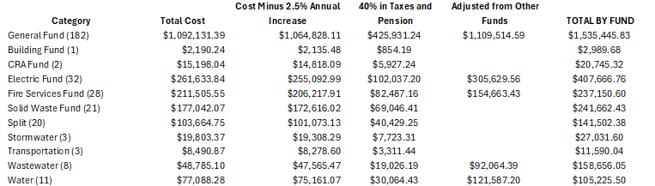
Fiscal Impact of New Pay Plan by Fund

Slide 36
Fiscal Impact of Implementation of the Market Rate Study
Fund | Amount
General Fund Increase | $46,372.51
Electric Fund Increase | $4,130.85
Fire Services Fund Increase | $22,868.58
Solid Waste Fund Increase | $40,310.40
Split | $24,561.31
Stormwater | $2,974.40
Water Fund | $31,179.20
W/WW-TCS Crew | $8,003.42
Fund Increases Based on 2.75% Step Progression Plan Adjustment

Slide 37
Will be Fully Funded within the Adopted Budget Estimated Cost $2.83 Million
Original $2.6 Million Fiscal Impact is included within Proposed Budget

Slide 38
Capital Improvement Program
47 Projects funded in the Five-Year CIP | $66,472,849
FY25-26 | FY26-27 | FY27-28 | FY28-29 | FY29-30 | FY30-31
$22,917,849 | $9,131,000 | $6,869,000 | $11,535,000 | $11,535,000 | $4,485,000
Project detail sheets included:
Large-scale Construction Projects
Renovation and Renewal (R&R) Programs
Carry-Forward FY24-25 projects that will not be completed

Slide 39
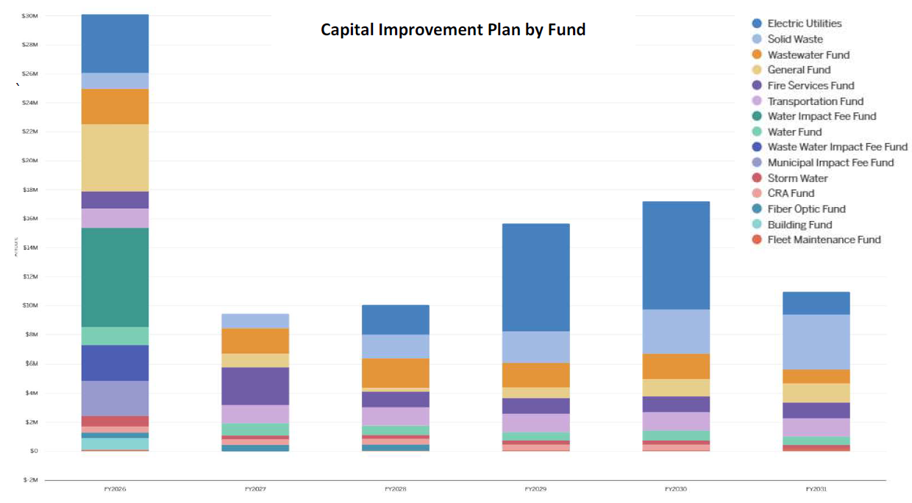
FY25-26 | FY26-27 | FY27-28 | FY28-29 | FY29-30 | FY30-31
$22,917,849 | $9,131,000 | $6,869,000 | $11,535,000 | $11,535,000 | $4,485,000

Slide 40
CIP Project List
$1 Million for continued Road Resurfacing projects
CRA Smart City Initiative
Street Light Improvement Program
Various Electric Utility expansions and system maintenance
Southeast Area Substation
James Farm Subdivision
Sand Lake Grove Subdivision
Jessie Drive Mobile Home Park
The Ranches at Lake McCleod
Idlewood Town Homes
Fire Public Safety Facility Planning
City Hall Remodel

Slide 41
CIP Project List
Parks and Recreation Improvements
Golf Course Cart Barn
ADA Playground at McLeod Park
Mary Holland Park – Pump Track
Mary Holland Park – Skate Park
Mary Holland Park Entrance/Roadway
Mary Holland Park – Fitness Trail
Pittas Baseball Complex Restroom and Concession
555 Sports Complex Parking Lot Lighting
Pedestrian Bridge Signage
Closed Circuit and Televising of Stormwater Infrastructure
Floral Avenue Stormwater Pipe Replacement

Slide 42
CIP Project List
Sewer Force Main Engineering on Old Bartow Eagle Lake Road
Water Main and Sewer Line Relocations at Highway 60 and US 17
Water Main Installation of a 24-inch Pipe
Water Interconnect with Polk County and Lakeland
Water Lead Line Service Replacement
Water New Ground Storage Tank
Water Sludge Drying Beds

Slide 43
CIP List – R&R Programs
CRA – Flood Mitigation and Drainage R&R Program
CRA - Sidewalk Enhancement R&R Program
Fiber Optic Infrastructure R&R Program
Inlet Replacement R&R Program
Lift Station R&R Program
City Facilities Air Conditioner R&R Program
Sewer Lateral R&R Program
Sewer Lining R&R Program
Sewer Manhole R&R Program
Water Transmission System Improvements R&R Program
Water Valve R&R Program
Transportation Signage R&R Program

Slide 44
Planned Spend Down of General Fund Reserves
Address infrastructure that is failing or poses a safety risk at our Parks and Recreation facilities | $3.3 Million
Construction of a municipal pool and aquatics program | $3.5 Million
Public Works Facilities Renovation | $2.5 Million
Addition of a joint Fire Services substation with Polk County in North Bartow to improve fire response times across the City | $5.2 Million

Slide 45
General Fund Overview Fiscal Year 2025-2026

Slide 46
City of Bartow Millage Rate History
Notes:
Change this back a year

Slide 47
Historic Taxable Value – City of Bartow

Slide 48
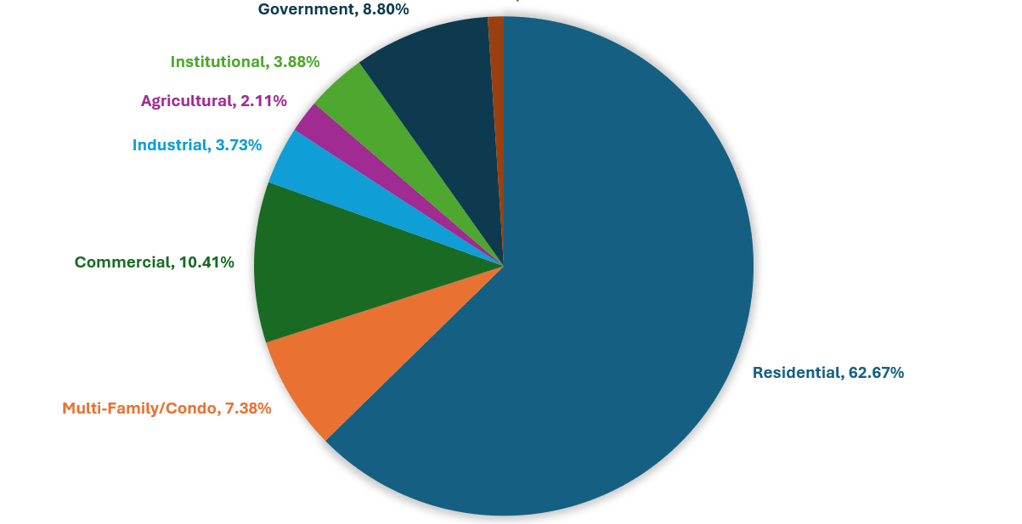
City of Bartow Property Breakdown by Type

Slide 50
General Fund Departments
City Clerk’s Office
City Manager’s Office
Code Compliance & Neighborhood Services
Finance
Human Resources
Information Technology
Parks, Recreation and Cultural Arts
Golf Course
Library
Parks and Recreation
Planning
Police
Public Works – General Fund Portion
Customer Service
Purchasing
City Commission

Slide 51


Slide 52
Department: City Commission |  | Division: N/A
Funding Source(s) | General Fund | # of FTEs | 5 Commissioners
Budget
 | FY 2024-2025 | FY 2025-2026 | Difference
Personnel | $403,076 | $261,517 | ($141,559)
Operating | $546,504 | $543,818 | ($2,686)
Grants & Aid | $1,412,897 | $1,474,998 | $62,101
Interfund Transfers | $7,155,316 | $2,184,443 | ($4,970,873)
TOTAL | $9,517,793 | $4,464,776 | ($5,053,017)
Notes:
Includes funding for City Commission Administration Travel and Training, City Attorney Fees and Funding for Grants in Aid to local Non-profit organizations. Includes Interfund Transfers for CRA and General Fund portion of Fire.

Slide 53


Slide 54
City Clerk’s Office
Vision | Mission
Proactively meet future challenges through expertise, succession planning, innovation, and a commitment to transparency. We aim to deliver exceptional customer service to our community, working collaboratively to continuously improve | Dedicated to fostering trust and confidence in local government by promoting transparency, engaging the community, ensuring compliance with regulations, and providing accessible services. We strive to deliver efficient, fair, and courteous support to all residents and stakeholders.

Slide 55
City Clerk’s Office
Department Goals
Maintain, preserve & provide access to city records Agenda preparation, transcribe minutes, coordination of public meetings and hearings, legislative assistance Fair and transparent municipal elections, filing clerk, disclosures, support canvassing board Preservation, accessibility, electronic records, staff training Timely responses, accurate information, continuous improvement Cross-department access, stakeholder engagement Digital access, apply new technology Staff development, integrity, open communication Adhere to all applicable state statutes and city ordinances regarding public records, elections and legal notices

Slide 56
City Clerk’s Office
Summary of Services
The City Clerk's department is responsible for managing the City’s official records and supporting municipal operations. These responsibilities ensure effective records management, transparency, and the smooth operation of city government.

Slide 57
Key Performance Measures
Measures | Analysis | Series | Status
Agendas Prepared | There have been 53 agendas prepared by the City Clerk through May of 2025 which is on target in comparison to last fiscal year. | Actual | 53
 |  | Prior Year Actual | 92
Board and Committee Applications Received, Processed, Appointed | There have been 11 applications received, processed and appointed by the City Clerk through May of 2025 | Actual | 11
 |  | Prior Year Actual | 19
Business Tax Receipts Renewed and Newly Issued | The City Clerk has renewed and issued 675 business tax receipts this far in 2025 | Actual | 675
 |  | Prior Year Actual | 729
Cemetery Internments | There have been 94 internments through May of FY2025 | Actual | 94
 |  | Prior Year Actual | 176
Number of Cemetery Plots Sold | There have been 102 cemetery plots sold through May 2025 | Actual | 102
 |  | Prior Year Actual | 122

Slide 58
Key Performance Measures
Measures | Analysis | Series | Status
Funding for Non-Profit/Community Applications Received | The City Clerk processed 18 applications in FY24 and 20 in FY25 | Actual | 20
 |  | Prior Year Actual | 18
Minutes Transcribed | The City Clerk has transcribed 67 minutes in FY25 which is on target in comparison to last fiscal year | Actual | 67
 |  | Prior Year Actual | 98
Proclamations Drafted, Coordinated, Issued | The City Clerk crafted 64 proclamations in FY25 which is a 16.36% increased compared to last year | Actual | 64
 |  | Prior Year Actual | 55
Records Processed/Dispositioned | There have been 83 cubic feet of records processed in FY25 | Actual | 83
 |  | Prior Year Actual | 120
Records Requests Processed | There have been 964 record requests through May of 2025 | Actual | 964
 |  | Prior Year Actual | 1,874

Slide 59
Department: City Clerk’s Office |  | Division: N/A
Funding Source(s) | General Fund | # of FTEs | 3 Full Time
Budget
 | FY 2024-2025 | FY 2025-2026 | Difference
Personnel | $317,721 | $349,899 | $32,178
Operating | $62,683 | $58,645 | ($4,038)
Capital | $0 | $84,000 | $84,000
Interfund Transfers | ($169,681) | $0 | ($169,681)
TOTAL | $210,623 | $492,544 | $281,921
Notes:
Eliminated negative interfund transfer and applied cost allocation to charges for service based on agenda items prepared by the Clerk’s Office

Slide 60
Major Initiatives – City Clerk
FY24-25
Innovation Fund Technology Project: Agenda Management System | to be completed Summer 2025
FY25-26
CIP Technology Project: Electronic Records Program | $84,000 in FY25-26

Slide 61


Slide 62
City Manager’s Office
Vision | Mission
Bartow is led with integrity, transparency, and innovation – ensuring a safe, financially healthy, vibrant and engaged community | Responsible for developing a high performing team that provides exceptional public service to enhance the quality of life for all residents, supports a thriving local economy, preserves our historic character and fosters a safe, connected and inclusive community.

Slide 63
City Manager’s Office
Department Goals
Provide the Vision and Strategy to Effectively Operate the City Support an Innovative Culture that Employs Technology and Best Practices Meet Customer Expectations Focus on Community Engagement and Neighborhood Activism Professionalize and Align City Policies and Practices
Summary of Services
The City Manager's Office provides overall leadership for the organization and all departments. In addition, the Communications Department is housed within the City Manager's Office.

Slide 64
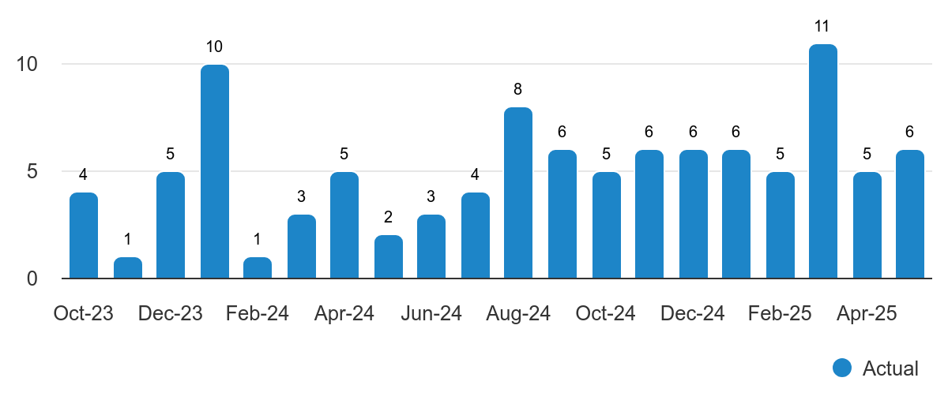
Key Performance Measures
Organizational Strategic Initiatives Completed by Month

Slide 65
Communications Key Performance Measures
City of Bartow Website
Total Users | 70.562
Total Page Views | 212,720
Average Session Duration | 2.15 Minutes
Bartow Now Downloads | 960
City of Bartow Facebook
Views | 782.2K
Reach | 149.7K
Content Interactions | 12.3K
Followers | 7,409
Week in Review
Issues Published | 14
Subscribers | 500
Open Rate | 42%

Slide 66
Department: City Manager’s Office |  | Division: N/A | Division: N/A
Funding Source(s) | General Fund | # of FTEs | # of FTEs | 6 Full Time
Budget
 | FY 2024-2025 | FY 2025-2026 |  | Difference
Personnel | $1,000,467 | $1,037,070 | $1,037,070 | $36,603
Operating | $166,482 | $348,690 |  | $182,208
Interfund Transfer | ($563,767) | $0 |  | $563,767
TOTAL | $603,162 | $1,385,760 |  | $782,598
Notes:
Eliminated negative Interfund Transfer using cost allocation model.

Slide 67
Major Initiatives – City Manager’s Office
FY24-25
HR Initiative: Prepare the Employer of Choice Initiative | To be Deployed in 2025
Innovation Fund Technology Project: Develop a Strategy and Performance Dashboard | to be completed Summer 2025
FY25-26
Strategic Planning: Conduct a City-Wide Strategic Planning Process
Innovation Fund Technology Project: Develop Transparency Reporting for the Public

Slide 68


Slide 69
Code Compliance and Neighborhood Services
Vision | Mission
A thriving Bartow where every neighborhood is safe, well-maintained, and fosters a strong sense of community, achieved through collaborative partnerships and proactive code compliance. | To create a safe, vibrant, and healthy neighborhoods through resident empowerment, education, collaboration, and community partnerships.

Slide 70
Code Compliance and Neighborhood Services
Department Goals
Increase Voluntary Compliance Enhance Public Awareness Improve Neighborhood Aesthetics Ensure Safe Living Environments Strengthen Community Partnerships Streamline Enforcement Process Utilize Data-Driven Approaches

Slide 71
Code Compliance and Neighborhood Services
Summary of Services
Code Compliance: Investigating Complaints: Receiving and investigating reports of potential violations of city ordinances related to zoning, property maintenance, building codes, signage, noise, and other local regulations. Violation Notices: Issuing notices of violation to property owners or responsible parties outlining the specific code infractions and required corrective actions. Follow-up and Compliance Monitoring: Tracking the progress of violation remediation and ensuring compliance within established timeframes. Legal Action (when necessary): Pursuing legal remedies, such as citations or magistrate orders, in cases of continued non-compliance.

Slide 72
Code Compliance and Neighborhood Services
Summary of Services
Neighborhood Services: Community Outreach and Education: Providing the information to residents and business about city codes, neighborhood resources, and community improvement initiatives through workshops, meetings, and informational materials. Neighborhood Laison: Serving as a point of contact and resource for neighborhood associations, community groups, and residents to address local concerns and facilitate communication with the city. Blight Reduction Programs: Implementing initiatives to address and prevent blight, such as coordinating clean-ups, promoting property maintenance, and connecting residents with resources for home improvement. Abandoned Property Management: Identifying and addressing issues related to vacant and abandoned properties to mitigate negative impacts on neighborhood safety and aesthetics. Facilitating Community Initiatives: Supporting resident-led efforts to enhance their neighborhoods, such as community gardens, neighborhood watch programs, and beautification projects.

Slide 73
Key Performance Measures
Inspections | 2023/2024 Totals | 2024/2025 FYTD Total | 2024/2025 Estimated Total
Total Inspections | 4510 | 532 | 850
Other Activity | 2023/2024 Totals | 2024/2025 FYTD Total | 2024/2025 Estimated Total
Lots Mowed / Abated | 28 | 52 | 90
Snipe Signs Collected | 2288 | 515 | 600
Unsafe Structures Declared | 6 | 4 | 8
Condemnations Declared | 4 | 4 | 6
Buildings Demolished | 3 | 4 | 5
Citations | 0 | 3 | 7
In-Person Citizen Contacts | 2079 | 1165 | 2000
Virtual Citizen Contacts | 2326 | 3956 | 5000
Assist Other Agency /Dept. | 21 | 53 | 75
Other | 154 | 185 | 350
Lien Searches | 677 | 445 | 750
Written Warnings | 2023/2024 Totals | 2024/2025 FYTD Total | 2024/2025 Estimated Total
Total Warnings | 594 | 61 | 325
Notices of Violation | 2023/2024 Totals | 2024/2025 FYTD Total | 2024/2025 Estimated Total
Trash / Debris | 21 | 5 | 25
Weeds / Overgrowth | 92 | 52 | 95
Property Maintenance | 188 | 16 | 45
Inoperable Vehicles | 14 | 8 | 20
All other | 19 | 22 | 70
Total Notices | 334 | 103 | 255
Magistrate Activity | 2023/2024 Totals | 2024/2025 FYTD Total | 2024/2025 Estimated Total
Cases Prepared | 34 | 26 | 35
Cases Presented | 18 | 6 | 12
Orders Prepared | 23 | 10 | 16
Analysis: Year over Year activity decreased between FY 2023-2024 and FY 2024-2025. FY 2023-2024 activity is higher because of the City-Wide survey and the resulting enforcement initiative conducted in February and March 2024. FY 2024-2025 activity is a more accurate representation of normal activity moving forward.
Investigations | 2023/2024 Totals | 2024/2025 FYTD Total | 2024/2025 Estimated Total
All Types | 315 | 70 | 110
Clearance Rate | 75% | 83% | 83%
Voluntary Compliance Rate | 65% | 89% | 89%
* Clearance Rate is Total Investigations Open vs. Cases Closed. Voluntary Compliance Rate is Cases Closed without Abatement or Magistrate Intervention.

Slide 74
Department: Code Compliance and Neighborhood Services |  | Division: N/A
Funding Source(s) | General Fund | # of FTEs | 4 Full Time
Budget
 | FY 2024-2025 | FY 2025-2026 | Difference
Personnel | $283,079 | $378,240 | $95,161
Operating | $178,946 | $201,634 | $22,688
Capital | $77,021 | $0 | ($77,021)
Interfund Transfer | ($51,114) | $0 | ($51,114)
TOTAL | $487,932 | $579,874 | $91,942
Notes:
Eliminated negative Interfund Transfer using cost allocation model.

Slide 75
Major Initiatives – Code Compliance and Neighborhood Services
FY24-25
CIP Technology Project (Carry-Forward): Building and Code Enforcement Software Implementation | To be Deployed by December 2025
Capital City Clean-Up: Pilot Initiative Under the Cleaner, Safer Neighborhoods Program Designed to Improve Communities and Increase Public Safety.
FY25-26
Strategic Planning: Code Compliance Accreditation
HR Initiative (Bright Idea): Implement Code Compliance Assistance Grant (Angel Fund)

Slide 76
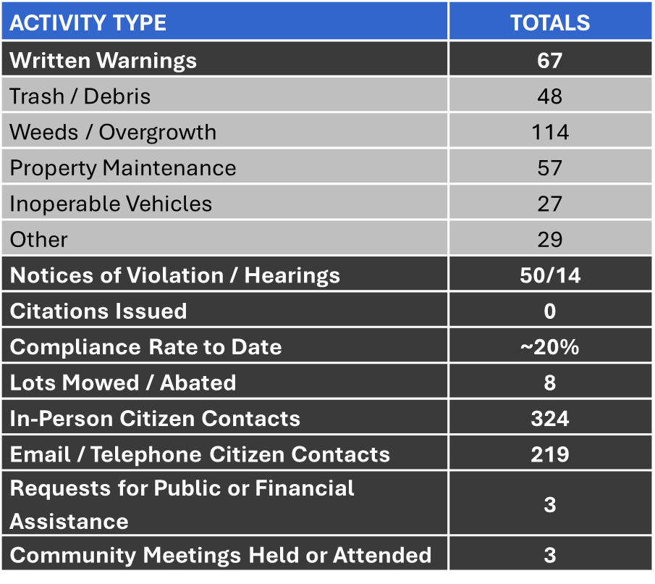
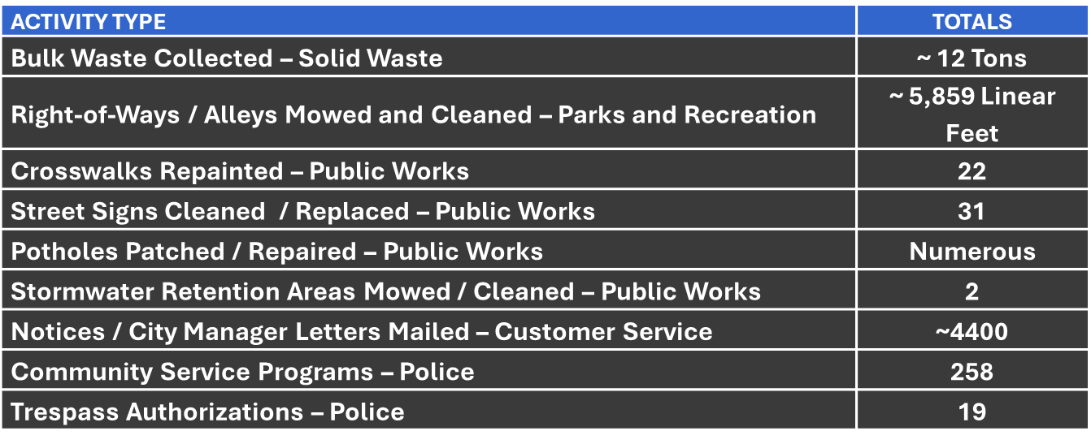
Major Initiatives – Code Compliance and Neighborhood Services
CAPITAL CITY CLEAN-UP
Enforcement Activity
Goal was to improve the aesthetic of each community and Address safety concerns and criminal activity.
The initiative ran from July 2024 – September 2024.
Program was postponed after Hurricane Milton.
Re-Activated in March 2025

Slide 77


Slide 78
Finance
Vision | Mission
To be the most knowledgeable and forward-thinking Finance Department in Polk County. Our culture of continuous improvement enables our trusted professionals to set the standard for employee excellence. | To achieve community outcomes by preserving the financial integrity and fiscal management of the organization, while assuring the availability of funds to accomplish the City's goals.

Slide 79
Finance
Department Goals
Ensure the City’s short and long-term financial status is healthy and sound Provide timely accurate financial reporting Ensure public funds and assets are invested prudently and are well managed Train user departments to better track financial data and improve intra-department partnerships
Summary of Services
Provide high-quality, dependable financial services to both departments and external vendors, including: Accounts Payable Financial Reporting Budget Development, CIP, and Oversight Treasury Management Procurement Fixed Assets Payroll Debt Management Customer Service/Call Center Operations Utility Billing

Slide 80
Key Performance Measures
Measures | Analysis | Series | Status
Calls Per Month | The Customer Service team has received 31,022 calls in FY25 | Actual | 31,022
Payments Collected By Type | There has been 33,579 utility payments collected as of June 2025. Online payments are the primary method of payment. | Actual | 33,579
Procurement Methods | The Purchasing team has issued 153 procurements using five different methods in FY 2025. | Actual | 153
Purchase Orders | There have been 7,670 purchase orders created, processed and filed in the current fiscal year | Actual | 94

Slide 81
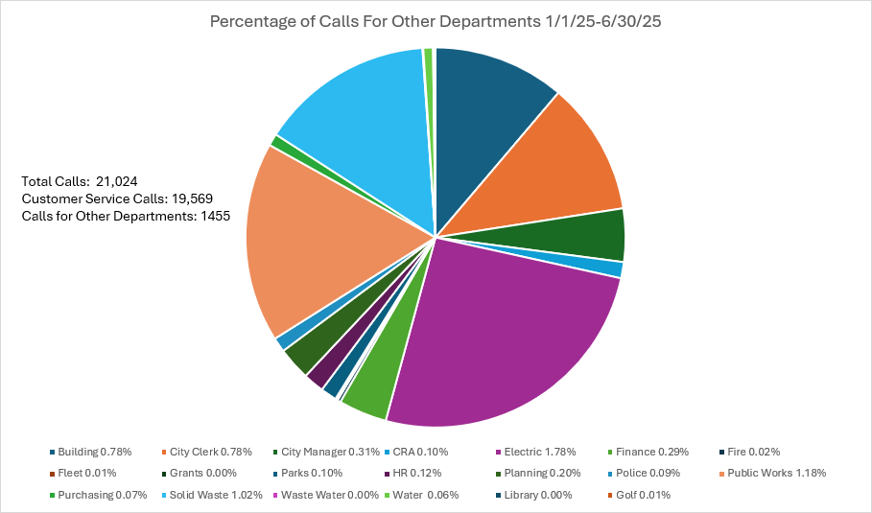
Key Performance Measure – Finance Customer Service

Slide 82
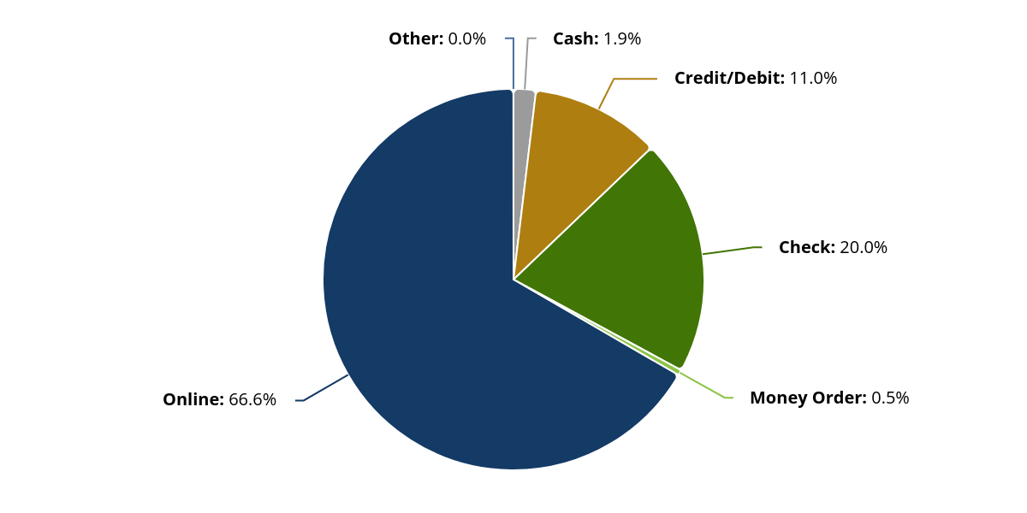
Key Performance Measure Finance Customer Service
Payments Collected By Type
33,579 Payments Collected in FY2025

Slide 83
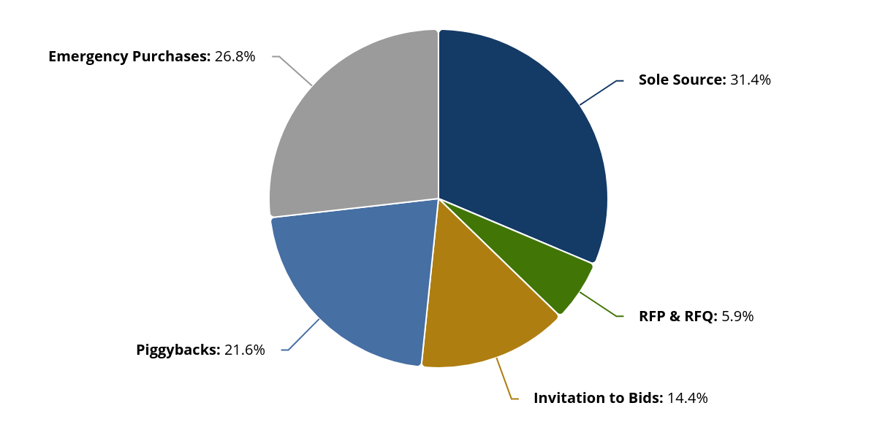
Key Performance Measure – Finance Purchasing
Procurement Methods
153 Procurements were conducted through May 2025

Slide 84
Department: Finance |  | Division: Administration
Funding Source(s) | General Fund | # of FTEs | 7 Full Time
Budget
 | FY 2024-2025 | FY 2025-2026 | Difference
Personnel | $700,782 | $951,642 | $250,860
Operating | $287,024 | $393,503 | $108,479
Interfund Transfers | ($456,295) | $0 | ($456,295)
TOTAL | $531,511 | $1,345,145 | $813,634
Notes:
Eliminated negative Interfund Transfer using cost allocation model. Reallocation of two Customer Service staff members to Finance Administration.

Slide 85
Department: Finance |  | Division: Customer Service
Funding Source(s) | General Fund | # of FTEs | 7 Full Time
Budget
 | FY 2024-2025 | FY 2025-2026 | Difference
Personnel | $866,186 | $669,441 | ($196,745)
Operating | $979,613 | $584,272 | ($395,341)
Capital | $45,000 | $0 | ($45,000)
Interfund Transfers | ($1,890,799) | $0 | $1,890,799
TOTAL | $0 | $1,253,713 | $1,253,713
Notes:
Eliminated negative Interfund Transfer using cost allocation model. Two less staff positions, reallocated to Finance Administration.

Slide 86
Department: Finance |  | Division: Purchasing
Funding Source(s) | General Fund | # of FTEs | 4 Full Time
Budget
 | FY 2024-2025 | FY 2025-2026 | Difference
Personnel | $359,149 | $386,011 | $26,862
Operating | $38,818 | $97,481 | $58,663
Interfund Transfers | ($176,062) | $0 | $176,062
TOTAL | $221,905 | $483,492 | $261,587
Notes:
Eliminated negative Interfund Transfer using cost allocation model.

Slide 87
Major Initiatives – Finance
FY24-25
Financial Planning: FY25-26 Annual Budget Process | Will be Completed in September 2025
Revenue: Implementation of Impact Fees | Municipal, Police, Fire, Facilities, Stormwater, Water and Wastewater
Revenue: Implementation of User Fees | Electric, Solid Waste, Water and Wastewater
FY25-26
Financial Planning: City-Wide Fee Structure Review
Technology Project: ERP Replacement
Financial Planning: FY26-27 Annual Budget Process
Financial Planning: Transition Payroll Function to Finance

Slide 88




Enterprise Resource Planning (ERP)
The City of Bartow ERP Project will tie together our budgeting, human resources, and asset management to create a modern environment for carrying out organizational policies and practices.

Slide 89


Slide 90
Human Resources
Vision | Mission
Create a culture of greatness and become the employer of choice for Central Florida. | Cultivate an inclusive and prolific workplace where all employees can grow and succeed.
Department Goals
Modernize HR department Ensure HR meets all statutory and legal compliance Improve employee recruitment and retention Focus on employee development, recognition and appreciation Wellness program initiatives

Slide 91
Human Resources
Summary of Services
Recruitment and Staffing Onboarding and Offboarding Training and Development Employee Engagement Performance Management Employee Compensation Employee / Retiree Benefits Safety / Workers Compensation Time and Attendance Reporting / HR Data Analytic Succession Planning Policy and Procedures Audits and Legal Compliance Employee Relations Labor Relations HRMS / Record Keeping

Slide 92
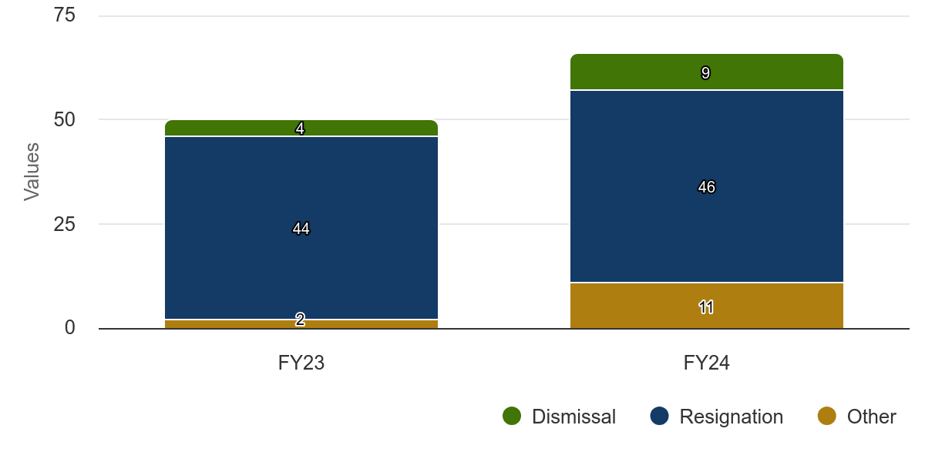
Key Performance Measures – Human Resources
Separations Per Year

Slide 93
Key Performance Measures
Measures | Analysis | Series | Status
Vacancy Rate | The City of Bartow currently has 56 vacant positions as of May 2025 | Actual | 13.18%
 |  | Target | 9.00%
Separations by Year | Human Resources received, processed and recorded 66 separations in FY24 which is a 32% increase from the previous year. There are 26 separations as of May 2025 where the predominate form of separation was retirements | Total Separations | 66
 |  | Prior Year – Total Separations | 50

Slide 94
Department: Human Resources |  | Division: N/A
Funding Source(s) | General Fund | # of FTEs | 3 Full Time
Budget
 | FY 2024-2025 | FY 2025-2026 | Difference
Personnel | $871,217 | $371,584 | ($499,633)
Operating | $314,609 | $357,352 | $42,743
Interfund Transfers | ($778,287) | $0 | ($778,287)
TOTAL | $407,539 | $728,936 | $321,397
Notes:
Eliminated negative Interfund Transfer using cost allocation model. Reduction in Personnel for Retiree Medical Costs moved to Employee Benefits Fund. Also responsible for the Employee Benefit Fund which currently funds retiree supplemental health insurance for $322,918.

Slide 95
Major Initiatives – Human Resources
FY24-25
HR Initiative: 2.5 STEP Adjustment | Completed by September 2025
HR Initiative: Implementation of Health Care Stipend | Complete
HR Initiative: IUPAT Contract | Ratified April 2025
HR Initiative: FOP Police Union Contract | In progress
HR Initiative Technology Project: Recruitment Platform | Launched April 2025
HR Initiative: Teamsters Contract | Ratified January 2025
FY25-26
HR Initiative: Develop a Health and Wellness Program
HR Initiative: Develop a Service Award Program
HR Initiative Technology Project: Implement HRMS
HR Initiative: Implement the PeopleMap Program
HR Initiative: Launch a New Employee Orientation Program

Slide 96


Slide 97
Information Technology
Vision | Mission
Transform city operations through innovative technology, setting the standard for municipal efficiency and delivering adaptive, forward-thinking services that meet evolving community needs. | Empower our city through innovative technology that delivers efficient services, supports data-driven decisions, ensures secure digital access, and fosters collaboration and innovation.

Slide 98
Information Technology
Department Goals
Enhance Cybersecurity Measures Modernize IT Infrastructure Enable Data-Driven Decision Making Facilitate Interdepartmental Collaboration Improve Citizen Service Delivery Promote Smart City Initiatives

Slide 99
Information Technology
Summary of Services
Infrastructure Management: Maintenance and management of network infrastructure, servers, and data centers to ensure reliability and security. Deployment and support for hardware and software systems across city departments. Cybersecurity and Data Protection: Implementing robust cybersecurity measures to safeguard data and systems from cyber threats. Regular security assessments, threat monitoring, and incident response to mitigate risks. IT Support and Helpdesk Services: Responsive technical support for city staff, including troubleshooting, software assistance, and device management. Telecommunications and Connectivity: Management of telecommunications infrastructure, including phone systems and internet connectivity for city offices and facilities. Digital Transformation and Innovation: Collaboration with city leadership to develop IT strategic plans aligned with organizational goals and priorities. Formulation of IT policies and procedures to ensure compliance with regulatory requirements and best practices in technology governance. Continuous evaluation of IT services and processes to identify opportunities for improvement and innovation. Modernize city processes, enhance service delivery, and improve citizen engagement Explore emerging technologies and trends to anticipate future needs and opportunities to improve residents’ quality of life.

Slide 100
Key Performance Measures
Measures | Analysis | Series | Status
Service Tickets Resolved | The IT Help Desk recorded 1,194 resolved tickets for service as of May 2025 which shows a significant increase from the previous year. | FYTD Actual | 1,194
 |  | PYTD Actual | 952
Customer Service Satisfaction Level | The Information Technology team has received a 4.91% customer service satisfaction rating in the current fiscal year for resolving issues in an efficient and timely manner | FYTD Actual | 4.91%
System Availability | The City of Bartow has a network system availability of 99.10% as of May 2025 | FYTD Actual | 99.10%

Slide 101
Department: Information Technology |  | Division: N/A | Division: N/A
Funding Source(s) | General Fund | # of FTEs | # of FTEs | 6 Full Time
Budget
 | FY 2024-2025 | FY 2025-2026 |  | Difference
Personnel | $530,428 | $629,789 |  | $99,361
Operating | $1,150,238 | $1,356,708 |  | $206,470
Capital | $433,000 | $812,000 |  | $379,000
Interfund Transfers | ($1,921,867) | $0 |  | ($1,921,867)
TOTAL | $191,797 | $2,798,497 |  | $2,606,700
Notes:
Eliminated negative Interfund Transfer using cost allocation model. Placed all technology platforms into IT budget (HRMS, ERP, Bartow.net). Continued funding for Innovation Fund. Institute lease laptop program.

Slide 102
Major Initiatives – Information Technology
FY24-25
Technology Project (Carry Forward): Develop a Plan for Technology Friendly Conference Spaces
Technology Project Innovation Fund: Laptop Program | Completed by September 2025
Technology Project: Laserfische Upgrade | Completed by September 2025
Technology Project Innovation Fund: Public Safety Applications for Citizen Complaints | Launched May 2025
CIP Technology Project: Work Order Asset Management System | Multi-year project in progress
FY25-26
Technology Project: Commission Chambers Audio/Visual
Technology Project: City Hall Security
Technology Project: Indoor Wifi Access Point Refresh
Technology Project: Network Rack Rebuilds

Slide 103


Slide 104
Parks, Recreation and Cultural Arts
Vision | Mission
Bartow is a vibrant community where all residents and visitors enjoy enriching recreational opportunities, well-maintained parks, and diverse cultural experiences that inspire healthy, active lifestyles and enhance overall quality of life. | City of Bartow Parks, Recreation and Cultural Arts Departments strives to promote passive and active recreational services, parks, and facilities that enrich the lives of all residents and visitors and promotes opportunities for a healthy lifestyle.

Slide 105
Parks, Recreation and Cultural Arts
Department Goals
Meet Customer Expectations/Satisfaction Strengthen Community Connections and Engagement Promote Well-being and Quality of Life (both Physical and Mental) High Performing Team that is Efficient and Effective Fostering Lifelong Learning
Summary of Services
Facilities: Rentals and Recreational Uses Athletic Programming: Youth and Adult Basketball, Contracted Youth Sports Leagues, Bartow Sports Complex for High Quality Tournaments Community Events: Blarney Duathlon, Father/Daughter & Mother/Son Events, July 4th Fireworks, Athletics Skills Competitions Senior Programming: Line Dancing & Seniors on the Move Health and Wellness: Well Care Dance Fit Class, Community Garden

Slide 106


Slide 107
Golf Course and Mulligans
Division Goals
Continue Reducing Subsidy Towards both the Golf Course and Mulligans Defend Our Title of Best Gold Course in the Community Choice Awards of Polk County Become One of the Top Places to Eat, Drink, Shop and Golf in Polk County Continuing Excellent Customer Service Increase Program Participation
Summary of Services
Deliver exceptional quality of life by offering: Golf for all ages Delicious food at fair prices High quality course conditions Social gathering experiences/events for residents and visitors in a friendly and welcoming environment

Slide 108
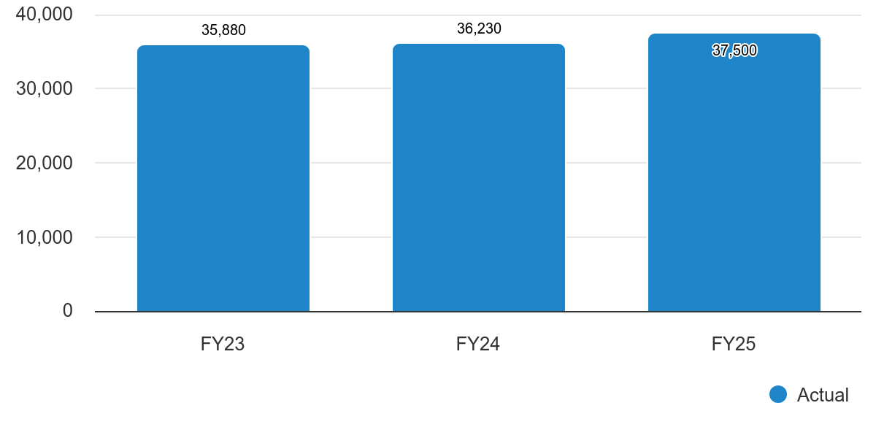
Key Performance Measures – PRCA Golf Course
Number of Golf Rounds
FYTD: 36,230 PYTD: 35,880
Analysis: The Bartow Golf Course recorded 37,500 golf rounds in the current fiscal year which has already exceeded last fiscal year’s total.

Slide 109
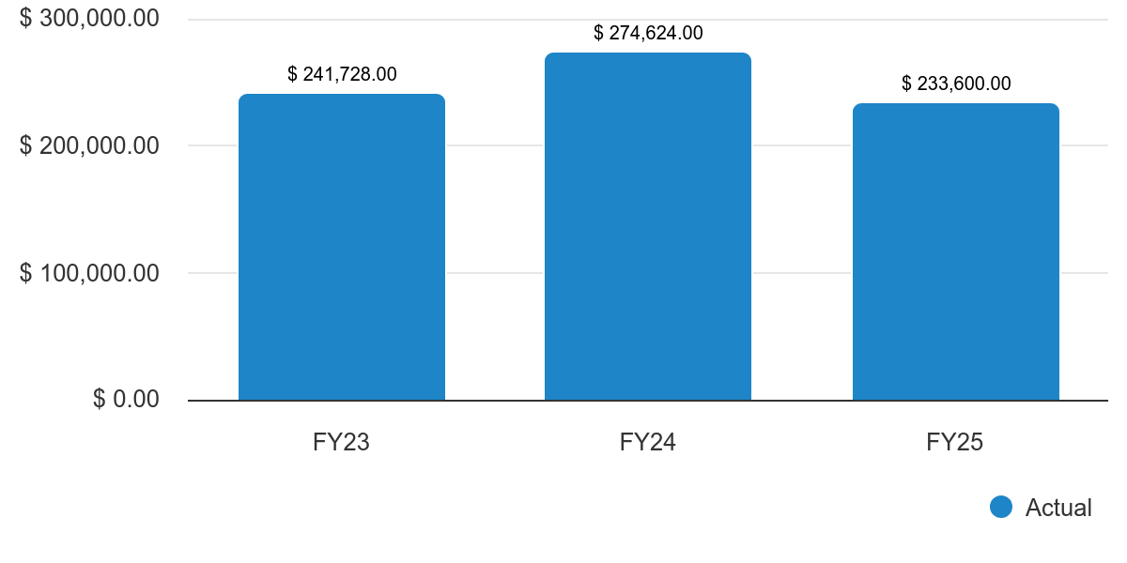
Key Performance Measures – PRCA Golf Course
Food and Beverage Sales
FYTD Actual: $233,600 PYTD TOTAL: $274,624
Analysis: Mulligan’s Bar and Grill brought in $274,624 in both food and beverage menu item sales for the current fiscal year and is on target to meet its goal for FY25.

Slide 110
Department: PRCA |  | Division: Golf Course | Division: Golf Course and Mulligans
Funding Source(s) | General Fund | # of FTEs: 32 Total (both divisions) | # of FTEs | 13 Full Time 19 Part Time
Budget
 | FY 2024-2025 |  | FY 2025-2026 | Difference
Personnel | $843,512 |  | $995,874 | $152,362
Operating | $429,841 |  | $730,121 | $300,280
Capital | $735,649 |  | $341,404 | ($394,245)
Interfund Transfers | $69,200 |  | $10,099 | ($59,101)
TOTAL | $2,078,202 |  | $2,077,498 | ($704)
Notes:
Reduction in capital expenditures. Employer of Choice Initiative costs for $15 minimum.

Slide 111
Department: PRCA |  | Division: Mulligans Restaurant | Division: Golf Course and Mulligans
Funding Source(s) | General Fund | # of FTEs: 32 Total (both divisions) | # of FTEs | 13 Full Time 19 Part Time
Budget
 | FY 2024-2025 |  | FY 2025-2026 | Difference
Personnel | $448,897 |  | $517,524 | $68,627
Operating | $378,197 |  | $430,466 | $52,269
Interfund Transfers | $19,417 |  | $0 | ($19,417)
TOTAL | $846,511 |  | $947,990 | $101,479
Notes:
Employer of Choice Initiative costs for $15 minimum.

Slide 112
Major Initiatives – Golf Course
FY24-25
CIP: Implement Golf Cart Lease Program | Completed January 2025
CIP: Golf Course Parking Lot | Completed by June 2025
Capital Equipment Purchase: Fairway Mower | Completed by March 2025
Capital Equipment Purchase: Slope Mower | Expected July 2025
FY25-26
CIP: Cart Barn New Build

Slide 113


Slide 114
Library
Division Goals
Provide services and programming that inclusively meets the needs of the community Advance literacy and lifelong learning through diverse collections, programs and services Expand outreach efforts to reach underserved populations and promote library programs
Summary of Services
Free library cards to Polk County residents A variety of adult and children’s programs Free e-books/audiobooks, streaming videos, and other electronic resources Public computers with Internet access and Microsoft products Free Wi-Fi extending to the parking lot Printing, faxing, and scanning services Meeting room and study rooms

Slide 115
Key Performance Measures
Measures | Analysis | Series | Status
Total Library Circulation | The Bartow Library has a total circulation of 275,000 in the current fiscal year | Actual | 275,000
 |  | Prior Year Actual | 267,003
Library Visits | There have been 59,000 visitors recorded by the Library in FY25 | Actual | 59,000
 |  | Prior Year Actual | 57,894
Number of Programs | There will be 470 programs at the Library in FY25 | Actual | 470
 |  | Prior Year Actual | 465
Attendance at Programs | There are 7,500 attendees at the various library programs in FY25 | Actual | 7,500
 |  | Prior Year Actual | 7,378

Slide 116
Department: PRCA |  | Division: Library
Funding Source(s) | General Fund | # of FTEs: 22 Total* | 16 Full Time 6 Part Time
Budget
 | FY 2024-2025 | FY 2025-2026 | Difference
Personnel | $667,680 | $679,850 | $12,170
Operating | $122,388 | $194,480 | $72,092
Capital | $50,000 | $50,000 | $0
Interfund Transfers | $2,172 | $0 | ($2,172)
TOTAL | $842,240 | $924,330 | $82,090
Notes:
* 7 Polk County Library Cooperative Employees

Slide 117
Department: PRCA |  | Division: Library COOP
Funding Source(s) | Library COOP | # of FTEs: 22 Total* | 16 Full Time 6 Part Time
Budget
 | FY 2024-2025 | FY 2025-2026 | Difference
Personnel | $168,651 | $179,425 | $10,774
Operating | $84,165 | $138,000 | $53,835
Capital | $240,000 | $90,000 | ($150,000)
Interfund Transfers | $1,328 | $0 | ($1,328)
TOTAL | $494,144 | $407,425 | ($86,719)
Notes:
Reduction in capital expenses.
* 7 Polk County Library Cooperative Employees

Slide 118
Department: PRCA |  | Division: Library COOP State Aid
Funding Source(s) | General Fund, Library COOP | # of FTEs: 22 Total* | 16 Full Time 6 Part Time
Budget
 | FY 2024-2025 | FY 2025-2026 | Difference
Personnel | $685,955 | $700,958 | $15,003
Operating | $12,000 | $12,000 | $0
Interfund Transfers | $841 | $0 | ($841)
TOTAL | $698,796 | $712,958 | $14,162
Notes:
* 7 Polk County Library Cooperative Employees

Slide 119
Major Initiatives – Library
FY24-25
CIP (Carry Forward): Story Trail

Slide 120


Slide 121
Parks and Recreation
Department Goals
Introduce New and Expand Athletic Leagues Provide Quality Special Events Expand Operating Hours
Summary of Services
Facilities: Rentals and Recreational Uses Athletic Programming: Youth and Adult Basketball, Contracted Youth Sports Leagues, Bartow Sports Complex for High Quality Tournaments Community Events: Blarney Duathlon, Father/Daughter & Mother/Son Events, July 4th Fireworks, Athletics Skills Competitions Senior Programming: Line Dancing & Seniors on the Move Health and Wellness: Well Care Dance Fit Class, Community Garden

Slide 122
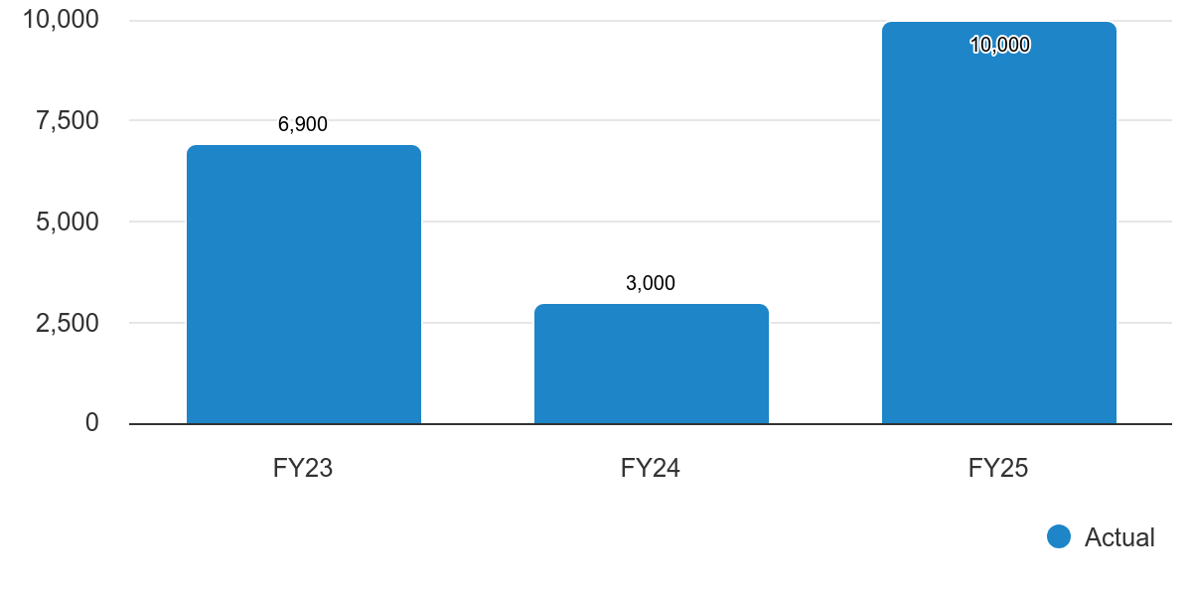
Key Performance Measure - PRCA
Social Media Interactions
FYTD Actual: 10,000 PYTD TOTAL: 3,000
Analysis: The City of Bartow Parks and Recreation Division social media page had 10,000 interactions through May in the current fiscal year.

Slide 123
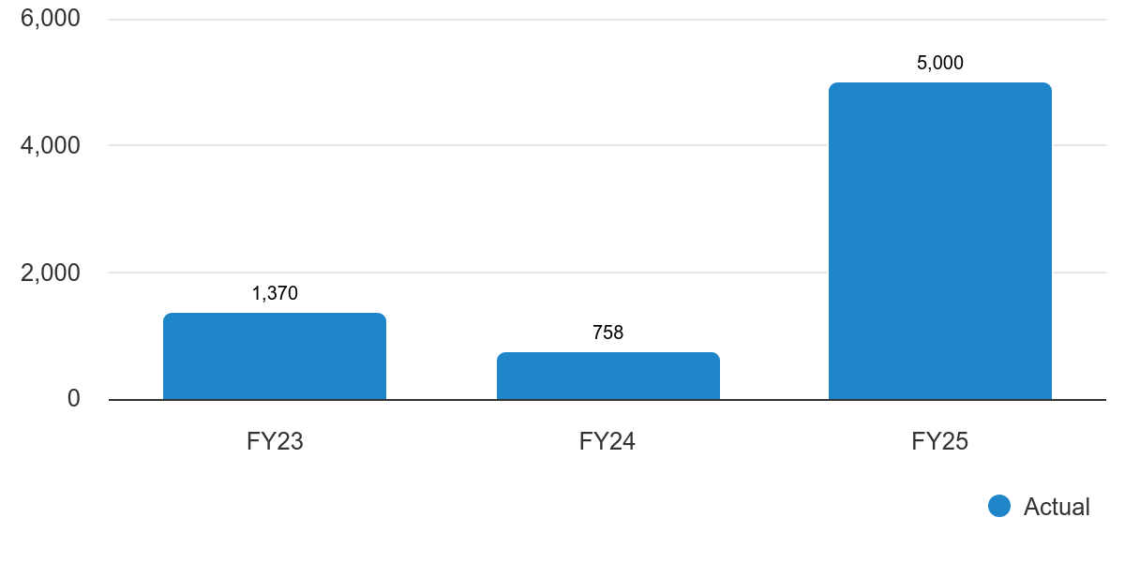
Key Performance Measure - PRCA
Participation
FYTD Actual: 5,000 PYTD TOTAL: 758
Analysis: Parks and Recreation recorded 5,000 participants for various programs and events in FY25 which is an outstanding jump in numbers compared to the previous year.

Slide 124
Department: PRCA |  | Division: Parks and Recreation
Funding Source(s) | General Fund | # of FTEs: 50 Total | 32 Full Time 18 Part Time
Budget
 | FY 2024-2025 | FY 2025-2026 | Difference
Personnel | $2,176,526 | $2,822,021 | $645,495
Operating | $2,421,165 | $2,748,318 | $327,153
Capital | $6,321,320 | $1,797,718 | ($4,523,602)
Debt Service | $87,561 | $0 | ($87,561)
Interfund Transfers | $349,296 | $129,117 | ($220,179)
TOTAL | $11,355,868 | $7,497,174 | ($3,861,694)
Notes:
Employer of Choice Initiative costs for $15 minimum. Reduction in capital expenses. Carry Forward CIP projects will roll forward.

Slide 125
Major Initiatives – Parks and Recreation
FY24-25
Strategic Planning (Carry Forward): Parks Master Plan
CIP (Carry Forward): Pool and Aquatics Program
CIP: Civic Center Tennis Courts | Anticipated completion by September 2025
CIP (Carry Forward): Richland Manor Athletic Court
CIP: Pittas Baseball Lighting | Completed
CIP: MHP Tot Playground Surface | Completed
CIP: Richland Manor Playground | Completed

Slide 126
Major Initiatives – Parks and Recreation
FY24-25
CIP: Carver Rec Roof Replacement – S. Building| Completed
CIP: Carver Recreation Center Restrooms | Completed
CIP: RC Track Barn and Roof | Completed
CIP: Polk Street Baseball Dugouts | Completed
CIP: Civic Center Kitchen | Completed
CIP: Carver Rec Kitchen Cabinets/Flooring | Completed
CIP: Carver Rec E/W Flooring | Completed
CIP: Athletics Maintenance Building | Completed
CIP: Civic Center Tennis Bleachers | Anticipated Completion by September 2025

Slide 127
Major Initiatives – Parks and Recreation
FY25-26
CIP: ADA Playground at McLeod Park
CIP: Bartow Sports Complex Parking Lot Lights
Service Enhancement: Deploy the Perry Weather System
CIP: Mary Holland Park – Pump Track
CIP: Mary Holland Park – Fitness Trail (Future Year)
CIP: Mary Holland Park Playground Replacement Proposal (Future Year)
CIP: Mary Holland Park Road
CIP: Mary Holland Park Skate Park

Slide 128
Major Initiatives – Parks and Recreation
FY25-26
CIP: Pittas Baseball Restrooms and Concession
CIP: Polk Street Parking Lot
Maintenance: Purchase Chairs for Civic Center, Carver Recreation and Polk Street

Slide 129
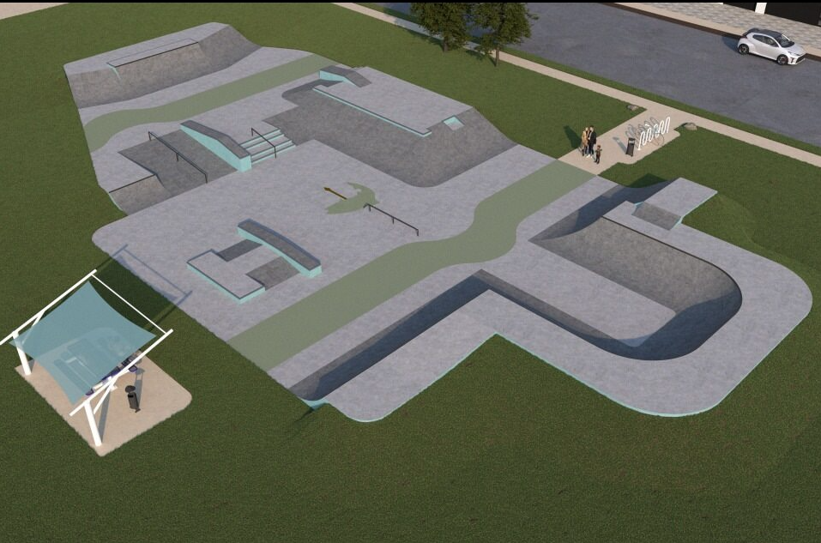
Mary Holland Park Skate Park
Capital Improvement Plan FY25-26
Skate Park Renderings
Prices are from the competitively bid out Sourcewell Contract
$425,000

Slide 130
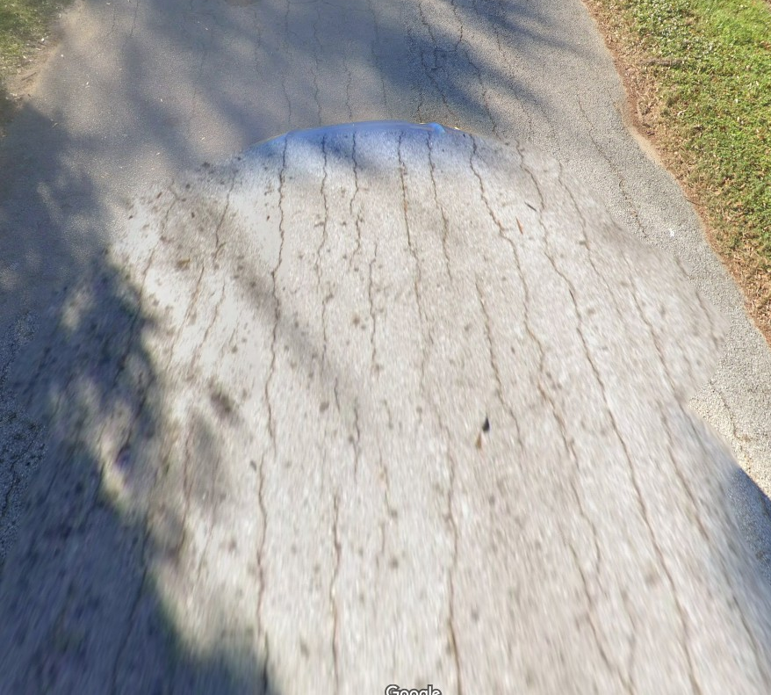
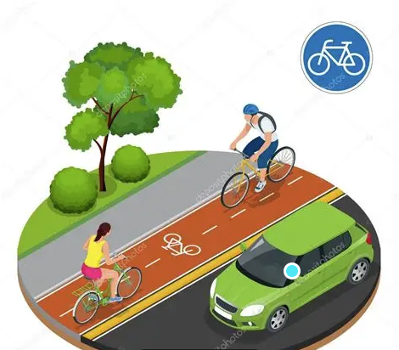
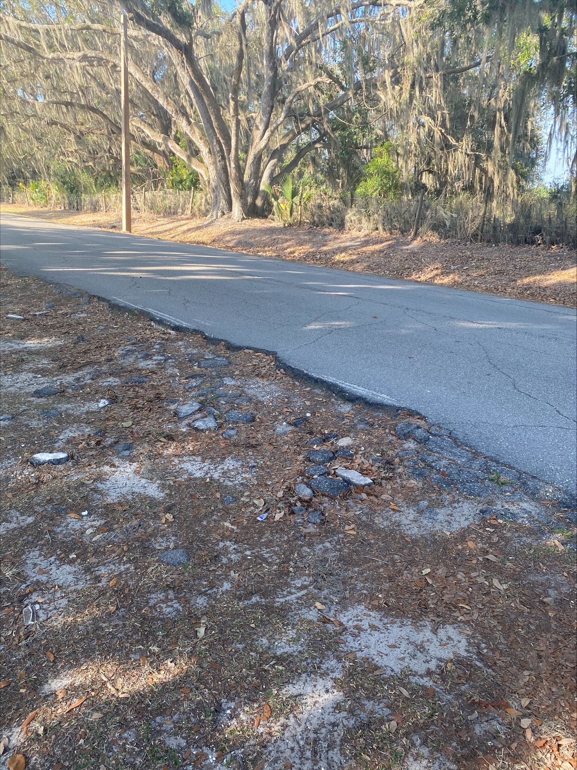
Capital Improvement Plan FY25-26
Project/Program Description | FY24-25 Budget (If applicable) | Requested Budget | Justification
Mary Holland Entrance and Road within Park | n/a | $929,000 | Roadway in a failing state that poses a risk to visitors of our most popular park

Slide 131
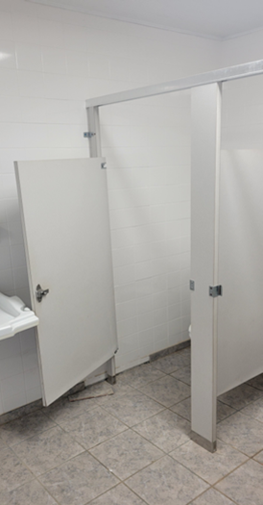
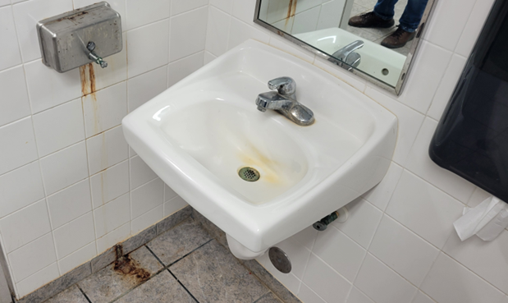
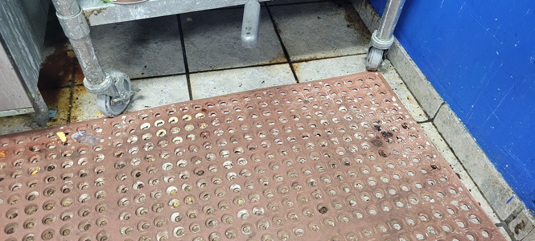
Capital Improvement Plan FY25-26
Project/Program Description | FY24-25 Budget (If applicable) | Requested Budget | Justification
Pittas Baseball Complex Restrooms/Concession Stand | n/a | $77,000 | Restrooms are in a state of disrepair. Repair costs are rivaling the replacement cost

Slide 132
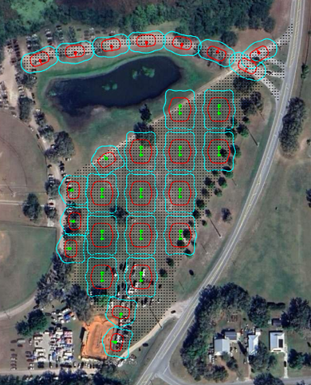
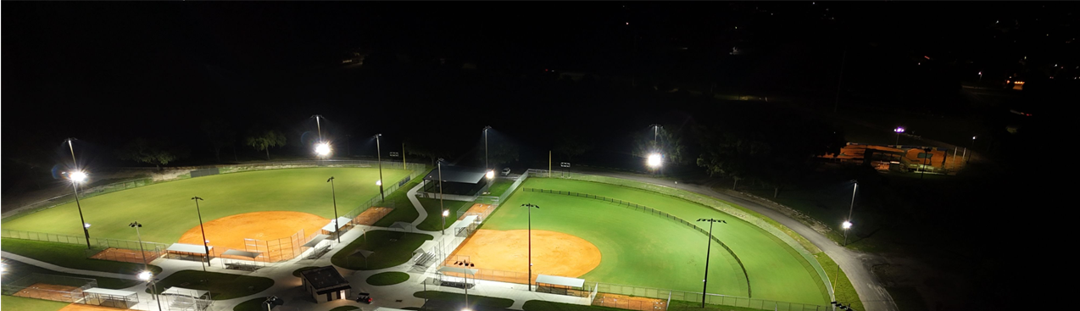
Capital Improvement Plan FY25-26
Project/Program Description | FY24-25 Budget (If applicable) | Requested Budget | Justification
Bartow Sports Complex Parking Lot Lighting (Solar) 27 light posts, install by City Staff, no reoccurring monthly expenses | n/a | $120,093 | Increase safety at sports complex when people return to their vehicles

Slide 133
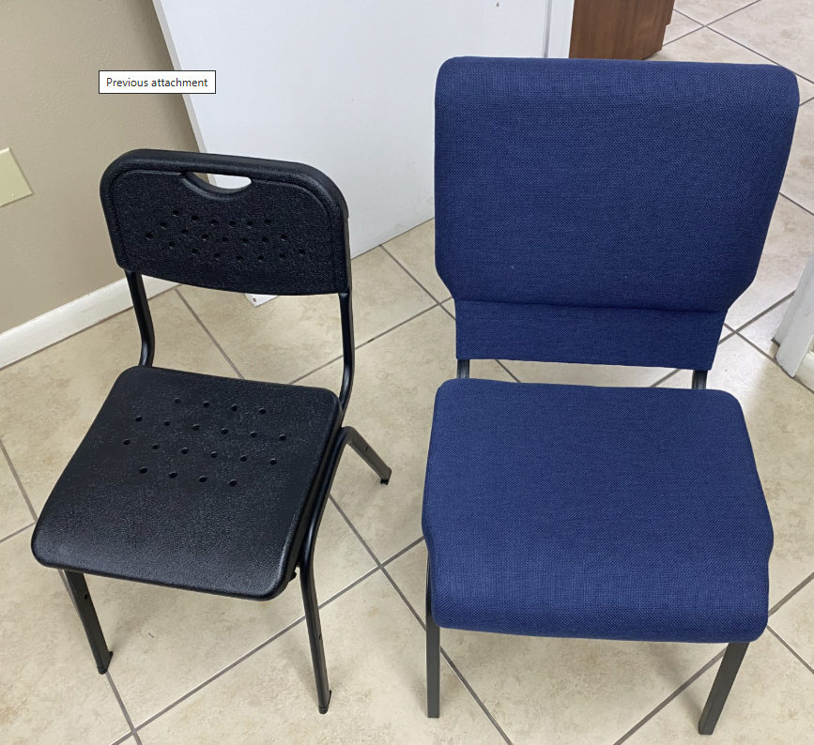
Capital Improvement Plan FY25-26
Project/Program Description | FY24-25 Budget (If applicable) | Requested Budget | Justification
Assembly Room Chairs | n/a | $90,000 | Current chairs are not adequate for functions
Current chairs are made of hard plastic with no padding
Proposed chairs are:
2 inches deeper
4 inches wider in the seat
Back support is 5 inches taller

Slide 134
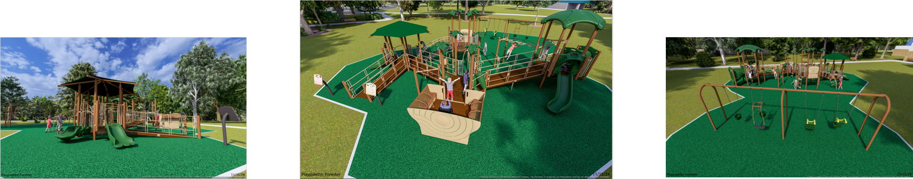
Capital Improvement Plan FY25-26
ADA Playground at McLeod Park
Budgeted Cost $400,000

Slide 135
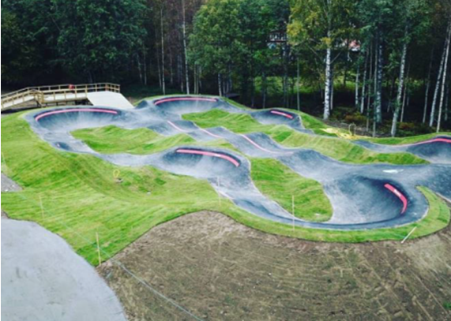
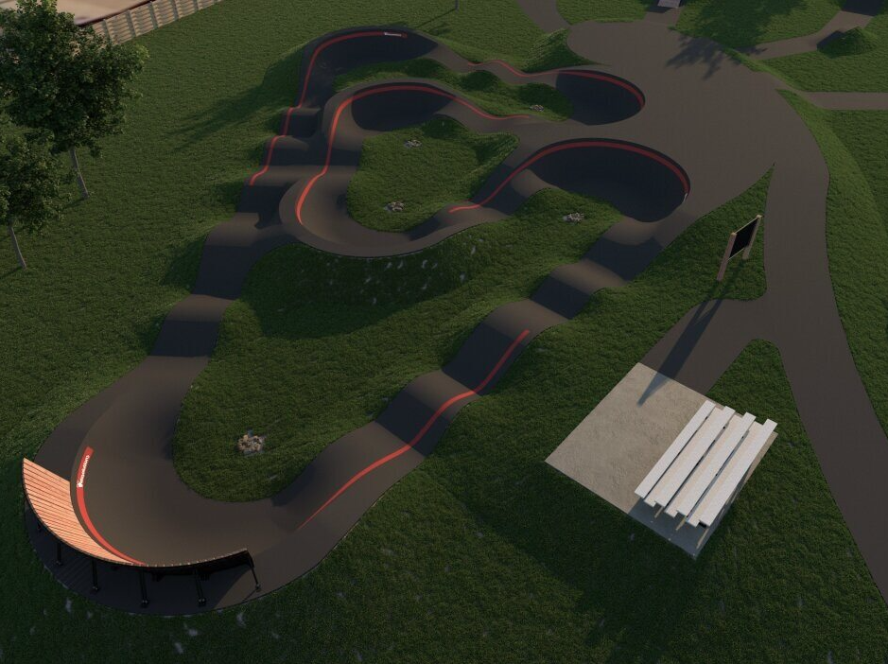
Mary Holland Park Pump Track
Capital Improvement Plan FY25-26
Pump Track Renderings
Prices are from the competitively bid out Sourcewell Contract
$475,000

Slide 136


Slide 137
Planning
Vision | Mission
To be the best place to do business; to work to create projects in the community that advance the City’s interests; and to assist citizens and others to more efficiently and seamlessly accomplish customer goals, thereby enhancing the built community and making Bartow the best place to live, work and play. | The Planning Department works with partners to build commercial value, thriving neighborhoods and an equitable community by assisting stakeholders in making sound decisions to create safe, orderly, and sustainable development.

Slide 138
Planning
Department Goals
Managed Planned City Growth Improve Community Quality of Life Minimize Environmental Impacts Promote Resilient Community Infrastructure and Resources Increase Community Taxable Value Provide for Equitable Ranges of Housing Options for Existing and Future Residents

Slide 139
Planning
Summary of Services
Prepares City Commission, Planning and Zoning Commission and Board of Adjustment public notices, agendas and staff reports; attends meetings; makes presentation and performs follow up activities as necessary Coordinates the functions of the City’s Development Review Committee Responds to requests for information from citizens, other City departments, consultants, and other government entities verbally and in writing; Researches and drafts amendments to the City’s Land Development Code and monitors effectiveness Researches and drafts amendments to the City’s Comprehensive Plan and monitors effectiveness Reviews development applications and prepares written reports to other City departments, applicants and other agencies; Assists walk-in and phone-in customers as needed

Slide 140
Key Performance Measures
Measures | Analysis | Series | Status
Population Increase | There was 4.09% increase in the City of Bartow population in FY24 as compared to FY23 | FYTD Actual | 20,502
 |  | YTD Percent Change | 4.09%
Residential Homesites Approved | There were 662 new residential homesites approved in FY24 and 237 in FY25 as of April 2025 | FYTD Actual | 662
Square Foot of Nonresidential Development Approved | There was 130,419 square foot of non-residential development applications approved in FY24 and 37,000 square feet approved in FY25 as of April 2025 | FYTD Actual | 130,419
New Development Projects Approved | There were 12 new Development Projects in FY24 and 42 applications submitted in FY25 as of April 2025 | FYTD Actual | 55
Number of Customers Assisted | The Planning Department continues to provide a high degree of customer service with 620 customers served as of April 2025 | Walk-in | 520
 |  | Phone | 960
 |  | Total Customers | 1,480

Slide 141
Department: Planning |  | Division: N/A
Funding Source(s) | General Fund | # of FTEs | 1 Full Time
Budget
 | FY 2024-2025 | FY 2025-2026 | Difference
Personnel | $158,155 | $186,174 | $28,019
Operating | $48,867 | $438,512 | $389,645
Interfund Transfers | $9,953 | $0 | ($9,953)
TOTAL | $216,975 | $624,686 | $404,711
Notes:
Applied cost allocation to charges for service based on agenda items prepared by the Clerk’s Office

Slide 142
Major Initiatives – Planning
FY24-25
Planning and Development (Carry Forward): Comprehensive Plan Update | Anticipated Completion by December 2025

Slide 143


Slide 144
Police
Vision | Mission
To build a safer Bartow through strong community partnerships, open communication, and practice policing – creating a city where trust, respect and collaboration between officers and residents are the foundation of public safety. | In partnership with our community, our mission is to maintain order, prevent and investigate crime and improve the quality of life of the citizens we serve.

Slide 145
Police
Department Goals
To provide a safe, secure environment for the citizen or and visitors to the City of Bartow, thereby, maintaining order and improving the City’s quality of life An overall reduction in crime through the use of criminal intelligence and shared information An overall reduction in crime through creative and innovative programs designed to educate and rehabilitate juvenile offenders Maintain agency’s accredited status through the various law enforcement accrediting bodies Build trust and legitimacy by increasing partnerships and citizen engagement through enhanced communication and participation with all stakeholders Enhanced local, state and federal partnerships to better provide services to our citizens

Slide 146
Police
Summary of Services
The Bartow Police Department is a full-service law enforcement agency, providing law enforcement related services to the citizens and visitors of Bartow. The department currently has an authorized strength of 49 sworn members and 25 civilian members. The department is primarily divided into two divisions: The Law Enforcement Division consists of: Uniformed Patrol, Support Services (Recruitment, Training, Traffic Enforcement, Community Services Team, Crime Analysis, Tactical Team, Explorers & Volunteers), Honor Guard, K-9 Units and the Reserve Officer Program The Support Operations Division consists of: Criminal Investigations Section, Records Section, Emergency Communications, Facilities and Crime Scene and Property & Evidence

Slide 147
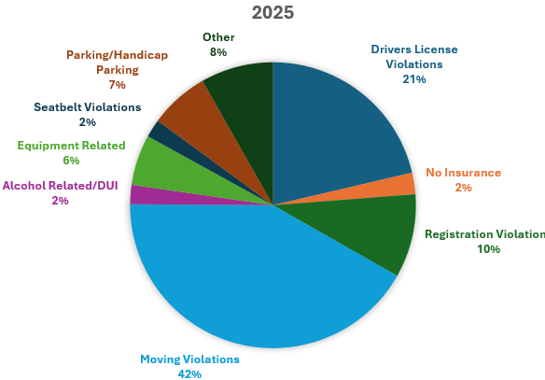
Key Performance Measures Police
Traffic Citations
There have been 1,607 traffic citations issued in 2025 year to date. There were a total of 2,486 citations issued in 2024.

Slide 148
Patrol Officer Essential Tasks

Slide 149
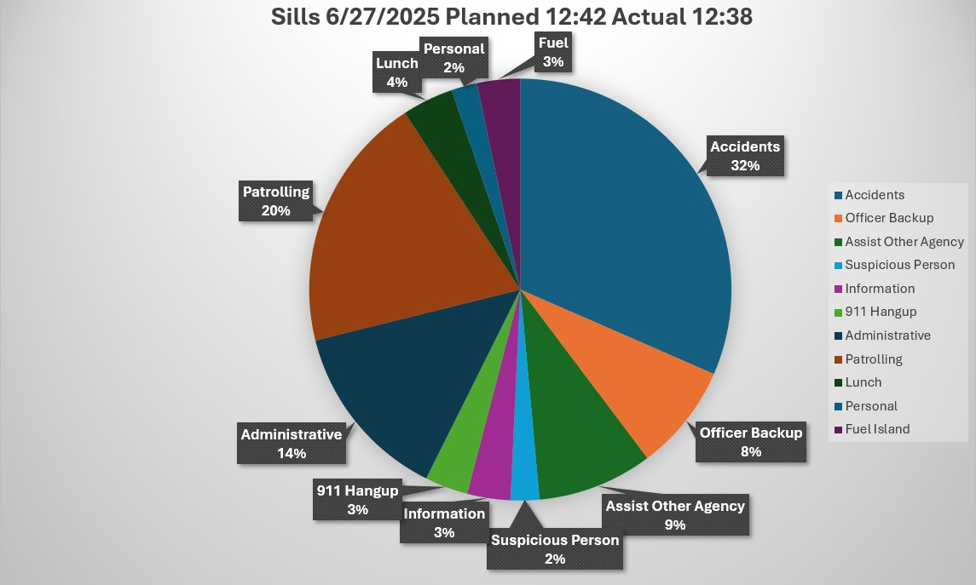
Key Performance Measures – Police
Sample Police Officer Daily Activities

Slide 150
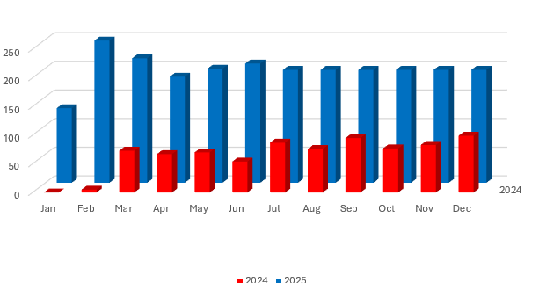
Key Performance Measures Police
Community Contacts by Officers – Park, Walk and Talk Initiative

Slide 151
Department: Police |  | Division: N/A
Funding Source(s) | General Fund | # of FTEs: 75 Total | 74 Full Time 1 Part Time
Budget
 | FY 2024-2025 | FY 2025-2026 | Difference
Personnel | $6,689,741 | $8,340,856 | $1,651,115
Operating | $972,960 | $1,276,414 | $303,454
Capital | $668,739 | $956,448 | $287,709
Grants & Aid | $12,000 | $12,000 | $0
Interfund Transfers | $1,144,326 | $351,186 | $793,140
TOTAL | $9,487,766 | $10,936,904 | $1,449,138
Notes:
Revision to Interfund Transfers. Employer of Choice Initiative salary increases.

Slide 152
Major Initiatives – Police
FY24-25
Operating: Institute Red Light Camera | Anticipated to be fully operational by September 2025
FY25-26
HR Initiative: Conduct a Recruitment Effort to Fill Police Officer Vacancies
Maintenance: Interior Remodel of Police Station

Slide 153
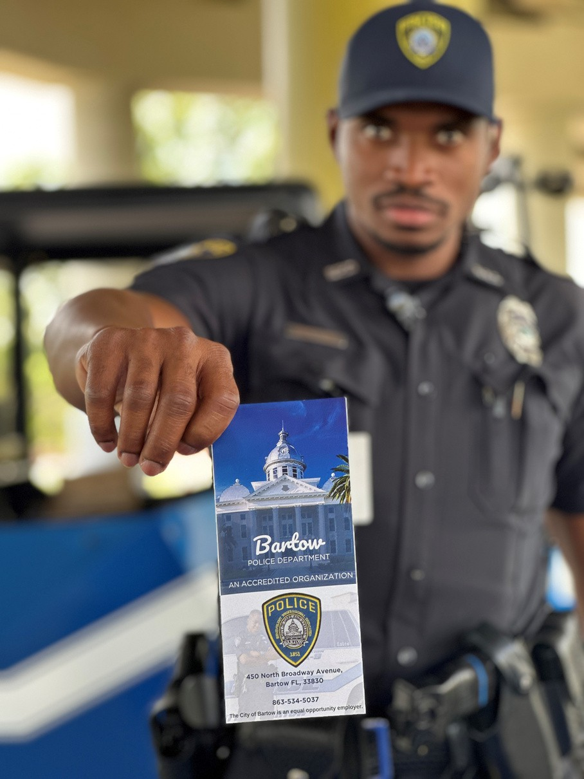
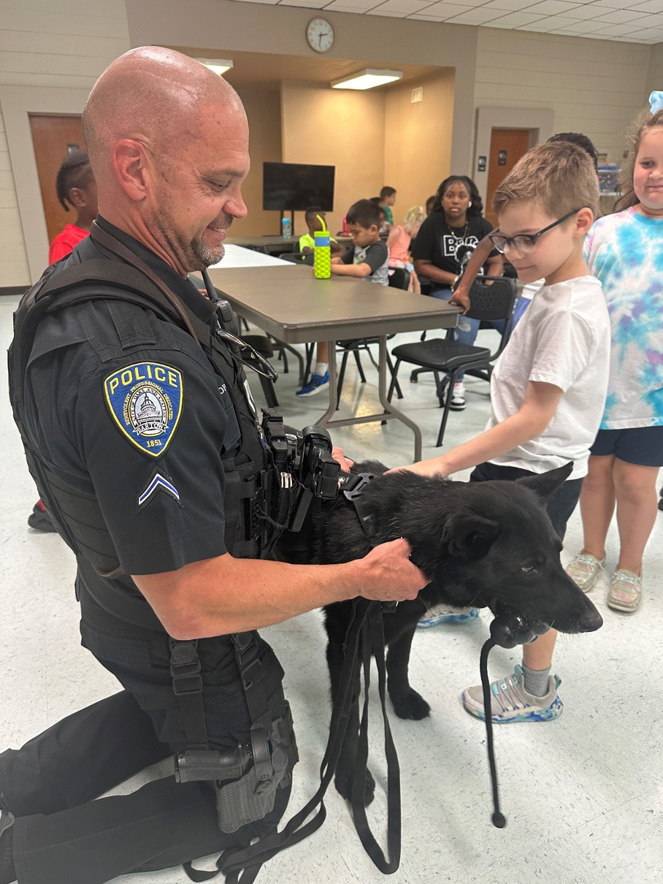
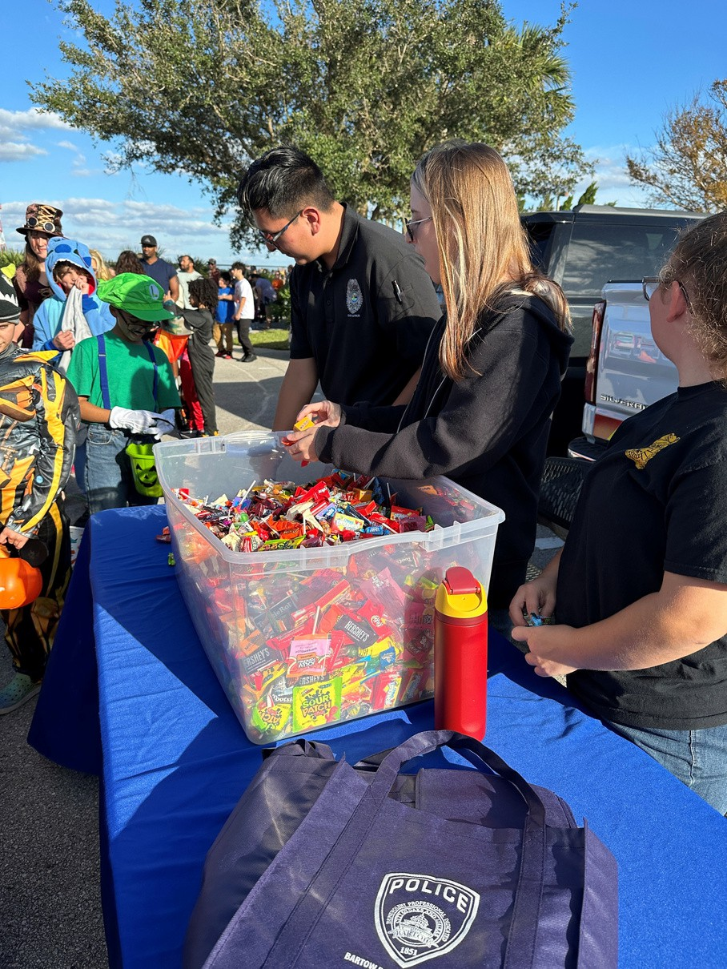
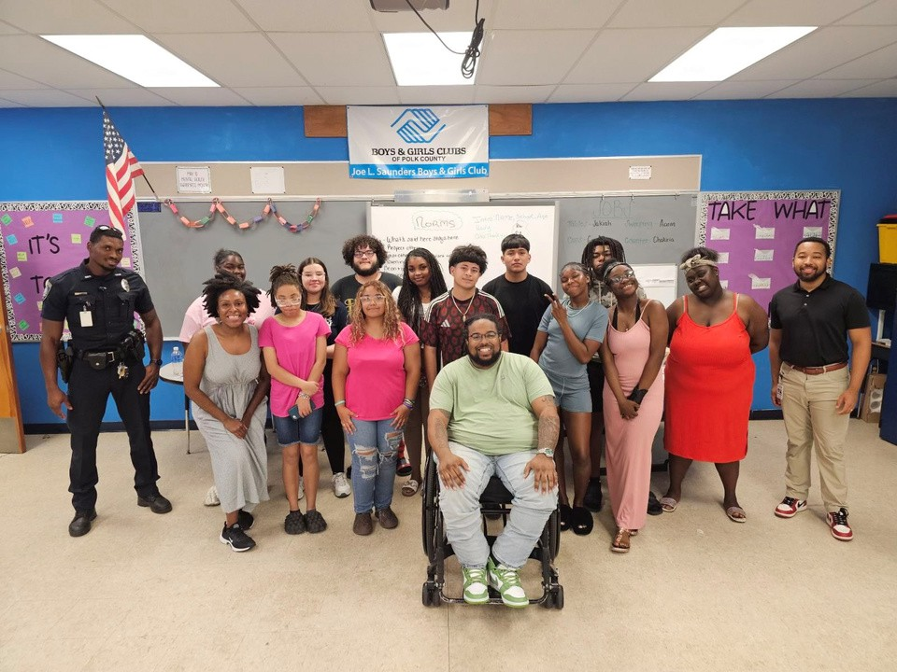
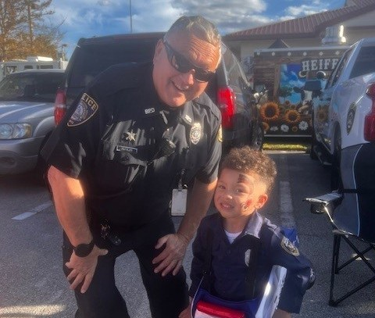
Recruitment Strategies
Recruitment Team, made up of group of diverse members to visit area Police Academies to recruit new officers
Attend hiring and community events to recruit members to the police department for both sworn and non-sworn openings
Increased the number of websites and targeted organizations for recruitment: Indeed, LinkedIn, Florida Police Chief’s Association, International Association of Chiefs of Police, Florida Division/International Association for Identification, Florida Association of Public Safety Communication Officials
Updated recruiting materials
New Pay/Step Plan, if approved, should significantly assist us in our recruiting efforts. Making us more competitive in the area market
Health Care Stipend and Signing Bonuses

Slide 154
2024 Police Department Recruiting
87 Total Applications Received
55 Male 63.2%
32 Female 36.7%
Ethnicity:
41 White 47%
27 Black 31%
14 Hispanic 16%
1 Asian 1%
1 Other 1%
3 Not Listed 3%
45 Law Enforcement Officer Applications Received
39 Male 86%
6 Female 13%
Ethnicity:
18 White 40%
15 Black 33%
11 Hispanic 24%
1 Other 2%

Slide 155
2024 Police Department Hires
17 Total Employees Hired
9 Male 53%
8 Female 47%
Ethnicity:
6 White 35%
4 Black 24%
7 Hispanic 41%
8 Law Enforcement Officers Hired
5 Male 63%
3 Female 37%
Ethnicity:
1 White 12%
3 Black 37%
4 Hispanic 50%

Slide 156
Police Body and Dash Camera Program
Year | Amount
January 2026 | *$496,834.40
January 2027 | $390,351.00
January 2028 | $390,351.00
January 2029 | $390,351.00
January 2030 | $390,351.00
TOTAL | $2,058,238.40
Lease Program Including:
50 Body Cameras
50 Tasers
45 Dash Cameras
Training
Software
* To Be Approved as Part of FY2025-2026 Budget in September Budget Hearings

Slide 157
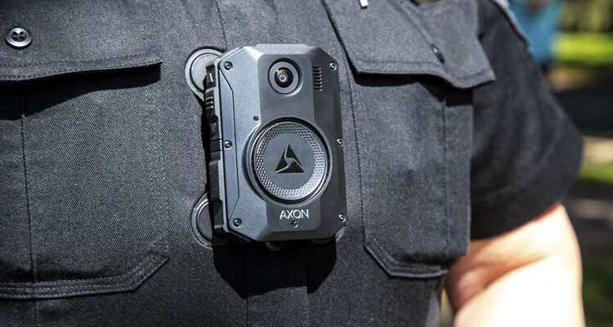
Axon Body 4 Camera
Includes Real-Time Translate – 52 languages can be translated in real-time
Unlimited Storage
Bookmarking and AI Assisted Redaction
Axon Auto Transcribe -Transcribing of Video and Axon AI Assistant, and Axon Records/Draft One - Assisted drafting of police report
Auto-activate when Taser is drawn; other officer’s camera is activated within 30ft; certain phrases
Ability for supervisor to live view if camera is activated, both In-Car and Body Cameras
Axon Evidence - Evidence Management
Third Party Video Support – ability to import and play third party videos and save into evidence
Training

Slide 158
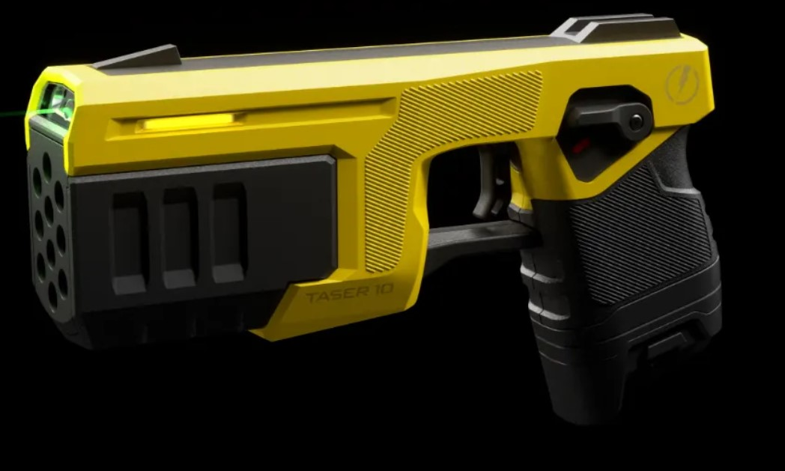
Taser 10
Integrated to Body Camera System, to activate camera when drawn
Includes Virtual Reality training system
COMMUNITY ENGAGEMENT TRAINING – Develops empathy, communication, and de-escalation skills through 360 video scenarios, including responses to mental health crises, peer intervention, personnel wellness, and interactions with diverse communities.
SIMULATOR TRAINING (RANGE SKILLS) – Immerses trainees in dynamic scenarios to practice decision-making, verbal commands, and tactical responses, as well as range specific modules for marksmanship and shooting proficiency.
VRBT TRAINING (LIVE ACTION) – Delivers realistic 360 video scenarios such as traffic stops, domestic disturbances, and active shooter incidents to build situational awareness and effective decision-making under pressure.
VRBT TRAINING (SIMULATOR) – Focuses on force options training through reality-based scenarios in a simulated environment, guiding trainees to make critical judgments and deploy appropriate tactics.

Slide 159
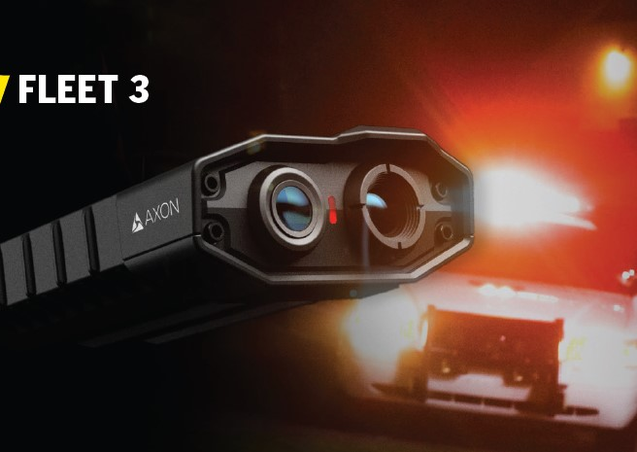
In Car Video System

Slide 160


Slide 161
Public Works – General Fund
Vision | Mission
The City of Bartow benefits from a vibrant and healthy community infrastructure system for today and tomorrow. | Our team works together to innovatively plan, build, and maintain safe and efficient infrastructure and assets.
Department Goals
Foster Collaboration and Teamwork Mitigate Risk and Execute Effectively in a Crisis Meet Customer Expectations Develop an Innovative Culture that Embraces Technology and Best Practices Develop and Implement Plans that are Future Focused Use Ingenuity to be Good Fiscal Stewards

Slide 162
Public Works – General Fund
Summary of Services
General Fund Facilities Maintenance Professional Services GIS & Mapping Asset Management through GIS Construction Management Infrastructure Development Development Review | Enterprise Funds Solid Waste Stormwater Underground Utilities (TCS) Water Wastewater Internal Service Funds Fleet Services Special Revenue Funds Transportation

Slide 163
Key Performance Measures
Measures | Analysis | Series | Status
Work Orders Completed Monthly | There are 2,002 work orders completed as of May 2025 | FYTD Actual | 2,002
 |  | PYTD Actual | 1,872
Repair Costs | Fleet Services spent $1,424,200 in repair costs on city vehicles and equipment in FY24 | FYTD Actual | $1,424,200.47
 |  | PYTD Actual | $1,279,203.97
Vehicles Replaced | There have been 29 vehicles in the current fiscal year | FYTD Actual | 29
 |  | PYTD Actual | 25
Tonnage of Solid Waste Collected by Type | As of May 2025 the Solid Waste Division recorded 14,867.69 tons collected for residential and commercial | FYTD Actual | 14,867.69
Street Sweeping Tons | Stormwater measured 2,000 street sweeping tons which is nearly double the prior year | FYTD Actual | 1,005
 |  | PYTD Actual | 948
Miles Paved | The Transportation Division paved 5.75 miles in FY25 | FYTD Actual | 5.76
 |  | PYTD Actual | 3.29
PCI Value | The pavement condition index (PCI) value target is 80 | FYTD Actual | 78.14
 |  | PYTD Actual | 76.26

Slide 164
Department: Public Works |  | Division: Professional Services and Facilities
Funding Source(s) | General Fund | # of FTEs | 9 Full Time
Budget
 | FY 2024-2025 | FY 2025-2026 | Difference
Personnel | $921,050 | $1,074,226 | $153,176
Operating | $755,822 | $516,128 | ($239,694)
Capital | $2,354,228 | $491,078 | ($1,863,150)
Interfund Transfers | $145,064 | $62,862 | ($82,202)
TOTAL | $4,176,164 | $2,144,294 | ($2,031,870)
Notes:
Prior year capital included the Public Works Administrative Building

Slide 165
Major Initiatives – Public Works
FY24-25
CIP: Roof at Fleet | Completed December 2024
CIP (Carry Forward): Public Works Administration Building
FY25-26
CIP R&R Program: City Facilities A/C Unit R&R Program
CIP: City Hall Remodel

Slide 166
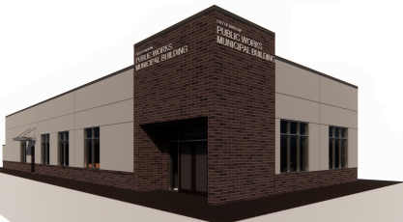
Public Works Administration
Project Timeline
Professional Services Period May 1 – May 31, 2025
Project Start Date (Field Work/Design) January 2026
Estimated Completion Late June 2026
Located at Mill Ave. Site

Slide 167
City Hall Remodel | Objectives
Create a more Customer Service friendly environment
Make entrance bright and inviting for our citizens and new lighting throughout the facility
Work with our CMAR partners to re-design the interior layout to maximize the space for offices, flex spaces and dedicated meeting rooms
Re-ducting of the A/C systems
Re-piping for plumbing issues
New Flooring
Updating restroom facilities
Improving the technology and sound systems in the chambers

Slide 168
Enterprise Funds Fiscal Year 2025-2026

Slide 169


Slide 170
Electric
Vision | Mission
Bartow Electric Utility exceeds our customer expectations and is recognized as a great place to do business in Polk County. Our team provides cost-effective, and timely services to our new customers and is a valued resource for our community's energy needs. We give back value to the community by providing lighting for a safer city and competitive energy services. We help make Bartow the Place to Be. | The Mission of the City of Bartow Electric Utility is to provide safe, reliable and efficient electrical services for our community. We are committed to maintaining a knowledgeable and competent work force, able to meet the challenges of a changing utility industry and expanding our utility to adapt to our hometown needs.

Slide 171
Electric
Department Goals
Enhanced Customer Experiences Create Efficiencies and Effectiveness in Service Delivery Improve Communication Maintain Tree Canopy Ensure Data Integrity
Summary of Services
The City of Bartow Electric Department provides electric service to over 13,115 customers with its 115 square mile service territory. We provide lighting for city streets, school bus stops, and for private yards. Our tree crew's trim trees for 265 miles of overhead lines and lights our city streets, parks, and alleys.

Slide 172
Key Performance Measures
Measures | Analysis | Series | Status
Utility Cut-Offs for Non-Payment | There is a total of 2,564 utility cut offs for Bartow customers that did not pay their utility bill through May 2025 | Actual | 2,564
 |  | Prior Year Actual | 3,510
Average Length of a Power Outage in Minutes | In the current Fiscal Year the average time it takes the Electric Department to restore power after an outage is 107 minutes which is a 20.3% increase over the prior fiscal year | FYTD Average | 107.01
 |  | PYTD Average | 96.60
Administrative Service Orders Created | There are 354 administrative service orders created in FY25 between streetlight maintenance and trouble calls | FYTD Actual | 354
Service Orders for Line Crew | The linemen recorded117 service orders between open and completed work in the current fiscal year | FYTD Actual | 117

Slide 173
Department: Electric |  | Division: N/A
Funding Source(s) | Electric Fund | # of FTEs | 40 Full Time
Budget
 | FY 2024-2025 | FY 2025-2026 | Difference
Personnel | $3,871,195 | $4,835,885 | $964,690
Operating | $22,308,918 | $24,284,950 | $1,976,032
Capital | $12,162,336 | $4,056,500 | ($8,105,836)
Debt Service | $102,992 | $0 | ($102,992)
Interfund Transfer | $11,682,583 | $6,273,356 | ($5,409,227)
TOTAL | $50,128,024 | $39,450,691 | ($10,677,333)
Notes:
Reduction in Capital expenditures. Reduction of Interfund Transfer through cost allocations.

Slide 174
Major Initiatives – Electric
FY24-25
CIP (Carry Forward): Flamingo Townhomes | On Hold
CIP: Hancock Crossing | Complete
CIP (Carry Forward): Idlewood Townhomes | On Hold
CIP: James Subdivision | Complete
CIP (Carry Forward): Jessie Drive Mobile Home Park | Slow progress
CIP (Carry Forward): Replace Control Building in Odom Substation
CIP: Retreat at Stuart Crossing | Complete
CIP: Sand Lake Grove | Complete
CIP (Carry Forward): Stuart Crossing – 200 New Homes | 50% Complete

Slide 175
Major Initiatives – Electric
FY25-26
CIP: New Southeast Area Substation
CIP: Street Light Improvement Program
CIP: Improvement from CR 640 to Highway 60 East

Slide 176
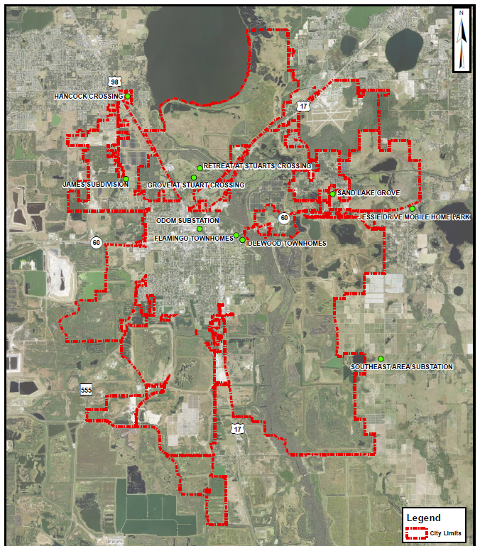
CIP Electric Site Locations

Slide 177
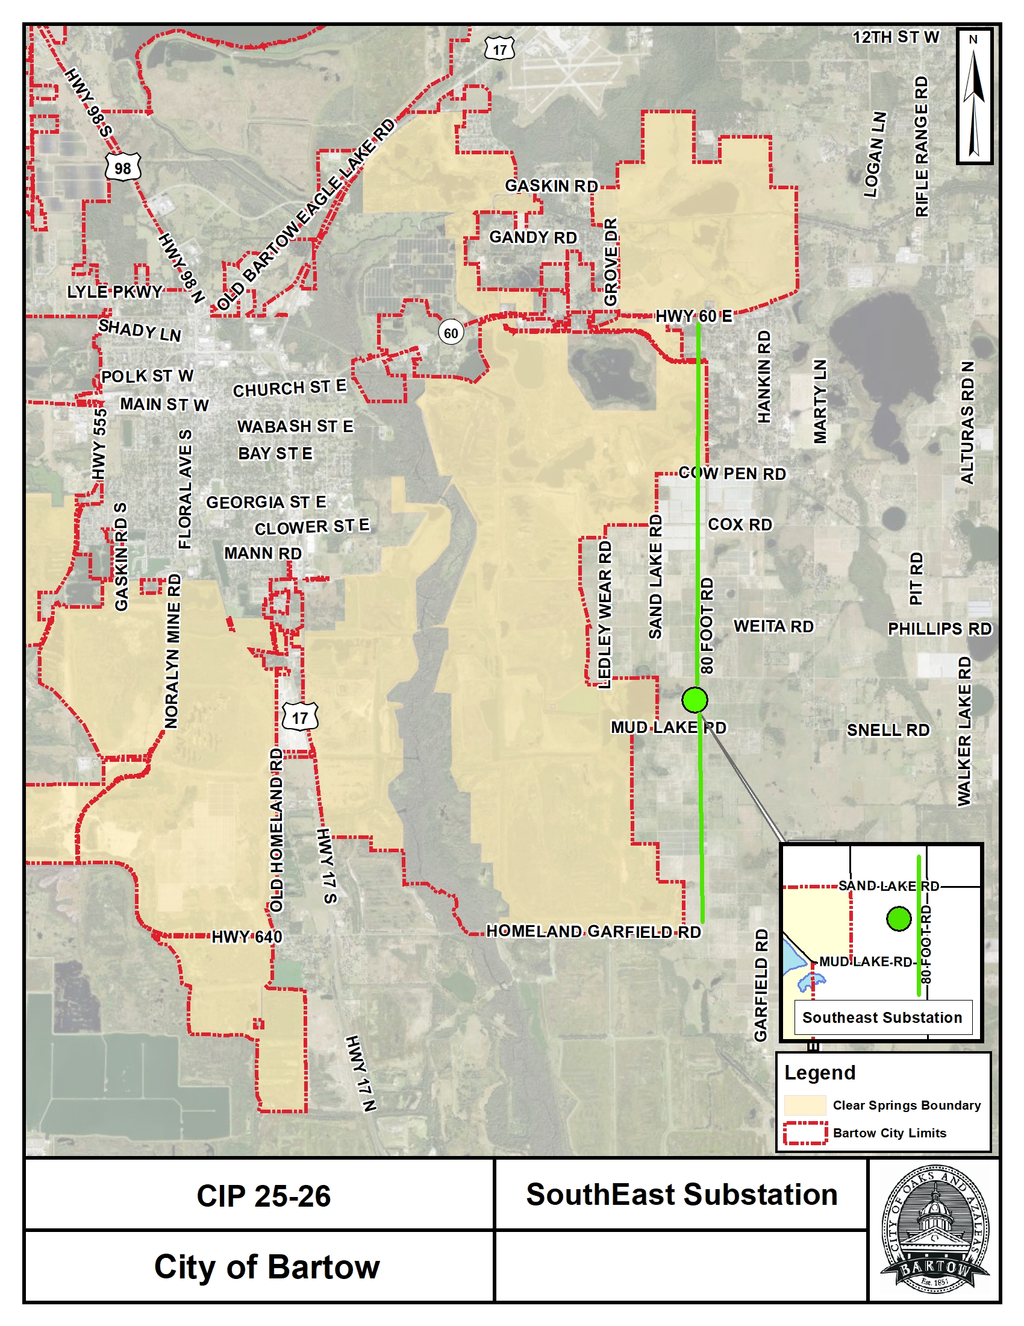
Electric: South East Substation
This CIP Project will focus on the purchase of land for the South East Substation and the initial design work of the station. This will increase electric capacity on the east side of Bartow and east of Peace River.

Slide 178
FIBER OPTIC FUND

Slide 179
Department: Information Technology |  | Division: Fiber Optic | Division: Fiber Optic
Funding Source(s) | Fiber Optic Fund | # of FTEs | # of FTEs | 1 Full Time
Budget
 | FY 2024-2025 | FY 2025-2026 |  | Difference
Personnel | $88,390 | $10,251 |  | ($78,139)
Operating | $300,860 | $156,082 |  | ($144,778)
Capital | $200,000 | $400,000 |  | $200,000
Interfund Transfers | $110,484 | $0 |  | ($110,484)
TOTAL | $699,734 | $566,333 |  | ($133,401)
Notes:
Unfunded position and changed the cost allocation method.

Slide 180
Major Initiatives – Fiber Optic
FY24-25
CIP (Carry Forward): Fiber Optic Master Plan
CIP Technology Project (Carry Forward): WIFI Expansion at Nye Jordan and Civic Center
FY25-26
CIP R&R Program: Fiber Optic Infrastructure R&R Program

Slide 181
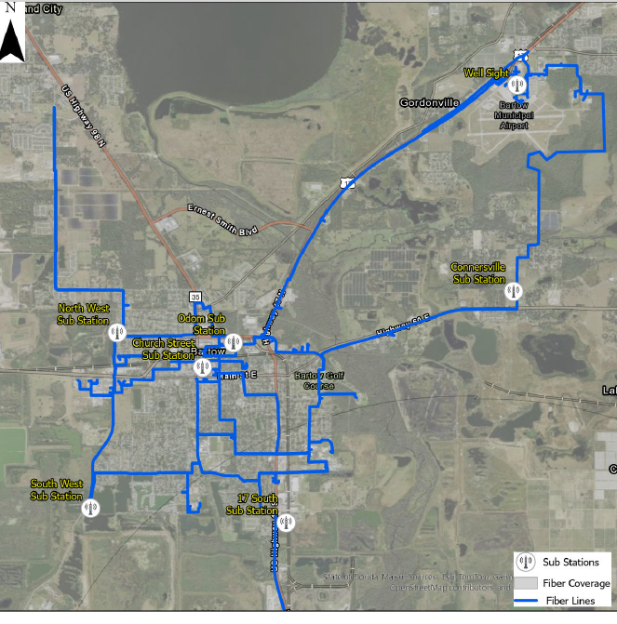
City of Bartow Fiber Ring
The City of Bartow Fiber Ring is an overhead system of fiber runs on the City’s electric poles that connects all City infrastructure and Utility SCADA. Additionally, Bartow Fiber supports our municipal partners such as the Airport Authority, Sheriff, Tax Collector and Polk County and a small amount of commercial customers.

Slide 182
Fiber Master Plan and Smart City Initiatives
Fiber Master Planning process to uncover fiber infrastructure needs and gaps in coverage such as:
Enhanced Wifi for events or public areas as a perk, public engagement, or as a service
Cameras and devices to monitor traffic and intersections with capability to change traffic lights to control traffic
Parking management, identify open parking places, on-line payment for parking
Street closures for events or construction
Cameras monitoring public areas for safety
Make broadband fiber available and affordable for targeted development areas. Universities, training facilities (live video), data transfer. Maybe pull the school board back in.
Control city buildings, lights, AC, water
On-line historical or cultural tours
Connectivity to all things City. Water’s SCADA, Wastewater’s SCADA, electric SCADA, AMI collectors, streetlight management, etc.
On-line location of Squeeze or other public transportation

Slide 183


Slide 184
Solid Waste
Vision | Mission
To lead in innovative waste management by reducing landfill use, expanding recycling efforts, and fostering a cleaner, greener Bartow through community partnership and operational excellence. | To provide timely, efficient, and environmentally responsible solid waste collection and disposal services that promote public health, cleanliness, and sustainability for the residents and businesses of Bartow.

Slide 185
Solid Waste
Division Goals
Foster Collaboration and Teamwork Mitigate Risk and Execute Effectively in a Crisis Meet Customer Expectations Develop an Innovative Culture that Embraces Technology and Best Practices Develop and Implement Plans that are Future Focused Use Ingenuity to be Good Fiscal Stewards
Summary of Services
Provide service to over 7500 households and all commercial accounts in the city limits. Residential Services - sanitation, recycle, yard waste, bulk junk, roll-off, and dumpster services Commercial - roll-off, dumpster, and recycle

Slide 186
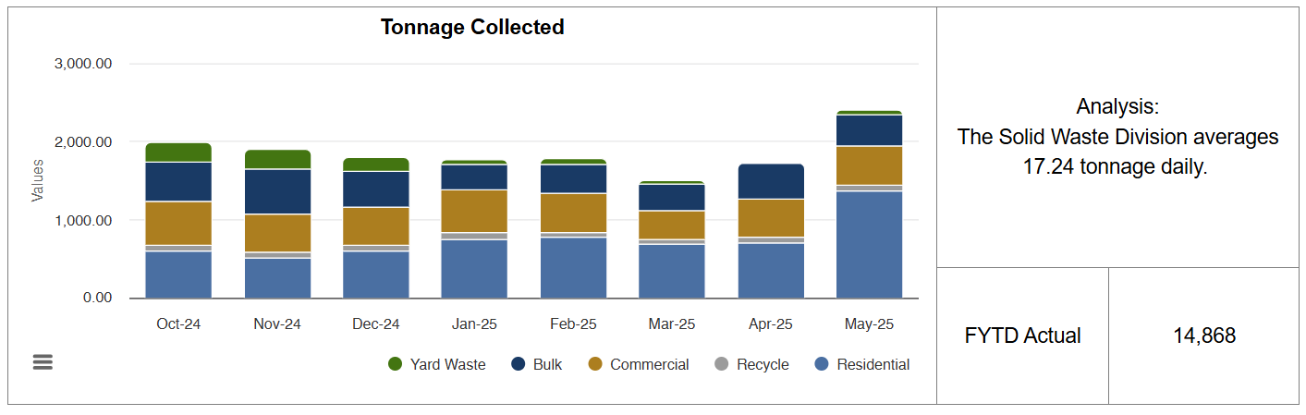
Key Performance Measures

Slide 187
Department: Public Works |  | Division: Solid Waste
Funding Source(s) | Solid Waste Fund | # of FTEs | 22 Full Time
Budget
 | FY 2024-2025 | FY 2025-2026 | Difference
Personnel | $1,477,563 | $1,781,186 | $303,623
Operating | $2,236,106 | $2,677,093 | $440,987
Capital | $2,066,582 | $1,071,199 | ($995,383)
Debt Service | $280,616 | $202,796 | ($77,820)
Interfund Transfers | $1,391,808 | $749,401 | ($642,407)
TOTAL | $7,452,685 | $6,481,675 | ($971,010)
Notes:
Reduction in Capital Expenses. Inclusion of one new position and Employer of Choice Initiative in Personnel. Republic Franchise Fee moved to General Fund.

Slide 188
Major Initiatives – Solid Waste
FY24-25
CIP (Carry Forward): Site Renovation Solid Waste

Slide 189
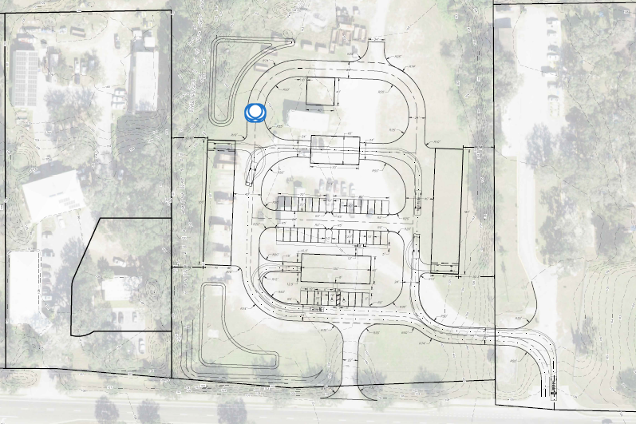
Solid Waste Facility
Project Timeline
June 2025 Update
Site plan completed
Civil Engineering plans completed
SWFMD Permit approved
FDOT site meet 7/16 /25
Construction/Site work will begin in November
Approximately one month for Planning
Approximately one month for Design
Approximately one month for Building Construction
Approximately one month for Interior completion
Estimated completion date is April 2026
Located at Current Solid Waste Facility

Slide 190


Slide 191
Stormwater
Vision | Mission
The City of Bartow benefits from a vibrant and healthy community infrastructure system for today and tomorrow. | Our team works together to innovatively plan, build, and maintain safe and efficient infrastructure and assets.
Division Goals
Foster Collaboration and Teamwork Mitigate Risk and Execute Effectively in a Crisis Meet Customer Expectations Develop an Innovative Culture that Embraces Technology and Best Practices Develop and Implement Plans that are Future Focused Use Ingenuity to be Good Fiscal Stewards

Slide 192
Stormwater
Summary of Services
Cleaning and maintaining drainage ditches Cleaning and maintaining stormwater ponds Cleaning stormwater inlets, outlets, and pipes Street sweeping services

Slide 193
What does the consumer get for their Stormwater Assessment fee?
Stormwater Assessment Overview
The Stormwater Assessment fee pays for the following: Operating Expenses NPDES regulatory inspections and maintenance of the stormwater system such as spraying of weeds, cleaning catch basins, cleaning lines, etc. Street Sweeping program including landfill fee’s Mowing of Stormwater locations Capital Improvements Large scale projects that improve the flow of stormwater in the City limits Annual catch basin refurbishing CIP R&R program which improves high risk locations making the neighborhoods safer and more attractive for residents Increase stormwater pond inventory by designing and building or purchasing of high risk private ponds that the City of Bartow determine will improve water quality and flows

Slide 194
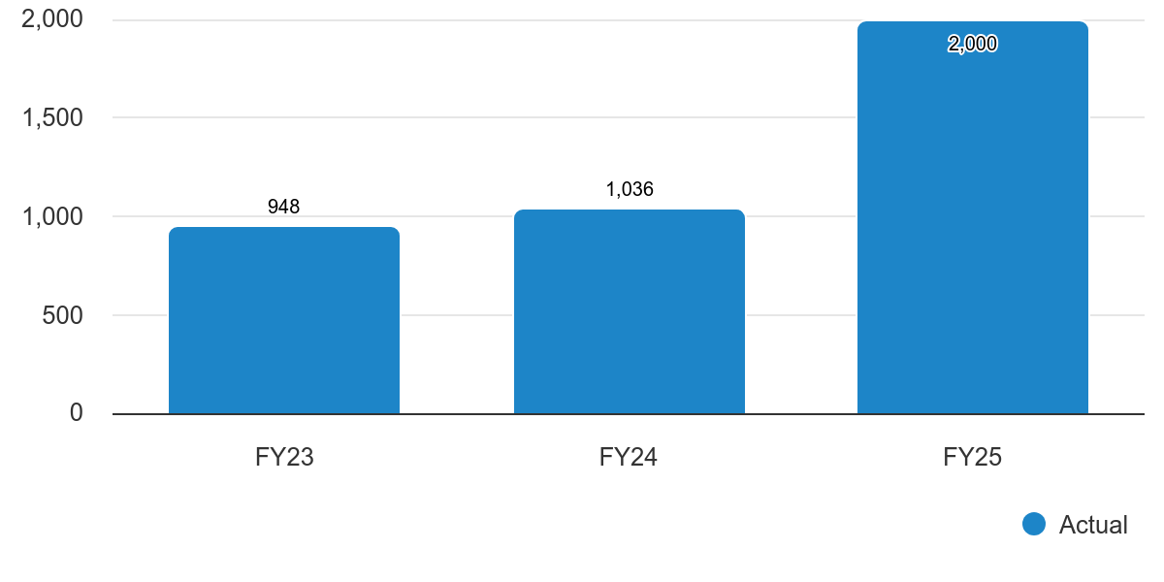
Key Performance Measure - Stormwater
FYTD Actual: 2,000 PYTD TOTAL: 1,036
Analysis: Stormwater measured 2,000 street sweeping tons in 2025 which has almost doubled the tons in FY24.
Street Sweeping Tons

Slide 195

Key Performance Measure - Stormwater
FYTD Actual: 300 PYTD TOTAL: 224
Analysis: The Stormwater Division cleaned 300 catch basins in FY25 which is on target when comparing the previous fiscal year.
Catch Basins Cleaned

Slide 196
Department: Public Works |  | Division: Stormwater
Funding Source(s) | Stormwater Assessment | # of FTEs | 4 Full Time
Budget
 | FY 2024-2025 | FY 2025-2026 | Difference
Personnel | $296,528 | $409,584 | $113,056
Operating | $759,028 | $777,506 | $18,478
Capital | $3,127,462 | $738,538 | ($2,388,924)
Interfund Transfers | $112,651 | $360,582 | $247,931
TOTAL | $4,295,669 | $2,286,210 | ($2,009,459)
Notes:
Reduction in Capital Expenditures.

Slide 197
Major Initiatives – Stormwater
FY24-25
Capital Equipment Purchase: Street Sweeper| Delivered July 2025
FY25-26
CIP: Closed Circuit and Televising of Stormwater Infrastructure
CIP: Floral Avenue Stormwater Pipe Replacement
CIP R&R Program: Inlet Replacement R&R Program

Slide 198

In-house Street Sweeping Improving Service Delivery

Slide 199

FY 25-26 Major Initiatives - Stormwater
City Stormwater system has a few areas with points of failure due to tree roots
The City will CCTV pipes and determine if we can clear the roots and line the pipe or a dig and replace with in house crews
Floral Avenue is a high priority area for 2025-2026

Slide 200

FY 25-26 – Stormwater Improvements

Slide 201


Slide 202
Underground Utilities (TCS)
Vision | Mission
The City of Bartow benefits from a vibrant and healthy community infrastructure system for today and tomorrow. | Our team works together to innovatively plan, build, and maintain safe and efficient infrastructure and assets.
Division Goals
Foster Collaboration and Teamwork Mitigate Risk and Execute Effectively in a Crisis Meet Customer Expectations Develop an Innovative Culture that Embraces Technology and Best Practices Develop and Implement Plans that are Future Focused Use Ingenuity to be Good Fiscal Stewards

Slide 203

Key Performance Measure – Underground Utilities (TCS)
FYTD Actual: 25 PYTD TOTAL: 27
Analysis: The Underground Utilities Division completed 25 manhole rehabs in FY25 which is on target in comparison to the previous fiscal year.
Manhole Rehab

Slide 204

Key Performance Measure – Underground Utilities (TCS)
FYTD Actual: 80 PYTD TOTAL: 86
Analysis: The Underground Utilities Division identified 80 broken valves within the City in the current Fiscal Year which is in addition to the 86 identified in FY24.
Broken Valves Identified

Slide 205
Department: Public Works |  | Division: Underground Utilities (TCS)
Funding Source(s) | Water | # of FTEs | 15 Full Time
Budget
 | Wastewater FY 2025-2026 | Water FY 2025-2026 | Difference | TOTAL
Personnel | $509,085 | $764,821 |  | $1,273,906
Operating | $240,718 | $367,660 |  | $608,378
Capital | $1,764,500 | $817,050 |  | $2,581,550
Interfund Transfers | $45,020 | $57,903 |  | $102,923
TOTAL | $2,599,323 | $2,007,434 |  | $4,566,757
Notes:
Public Works Division Underground Utilities (TCS) budgeted within the Water and Wastewater Funds

Slide 206


Underground Utilities (TCS) Building
July 2025 Status
Steel Building is currently on backorder - ETA is roughly 4 months out
Construction of the building once delivered takes approximately 3 weeks
Interior Build takes approximately 2-3 weeks
The current Estimated time of completion is late December/ Early January

Slide 207
Major Initiatives – Underground Utilities (TCS)
FY24-25
CIP (Carry Forward): TCS Underground Utility Building | Anticipated Completion by Winter 2025-2026
CIP: Red Zone Sanitary Sewer Inspections Program | Anticipated Completion by September 2025
FY25-26
CIP: Sewer Force Main Repair on Old Bartow Eagle Lake Road
CIP R&R Program: Sewer Lateral R&R Program
CIP R&R Program: Sewer Lining R&R Program
CIP: Water Main Relocation at Highway 60 and 17

Slide 208
Major Initiatives – Underground Utilities (TCS)
FY25-26
CIP: Wastewater System Line Relocation at Highway 60 and 17
CIP R&R Program: Valve Replacement R&R Program
CIP R&R Program: Water Transmission System Improvements R&R Program

Slide 209


Slide 210
Utilities
Vision | Mission
Set a standard of utility excellence in Water and Wastewater Services that will provide sustainable and reliable utilities for generations to come. | Strategically provide high quality water and wastewater services through dedicated employees who deliver exceptional value to our customers and the community we serve.
Department Goals
Provide reliable infrastructure Be environmentally responsible Protect the health and safety of the community Meet customer expectations Enable the success of our high performing team

Slide 211


Slide 212
Wastewater
Vision | Mission
Set the standard for utility excellence. | Strategically provide a reliable high-quality effluent at the lowest cost possible, in an environmentally responsible manner.
Division Goals
Promote safety in our workplace Deliver superior customer service Pursue organizational excellence through leadership and professionalism Practice environmental stewardship by protecting natural resources and minimizing environmental impacts

Slide 213
Wastewater
Summary of Services
Lift Stations (43) Operations and Maintenance: Pumps, Panels, Generators, and Piping Water Reclamation Facility: Preliminary Treatment: Prepares Wastewater for Treatment Process Primary Treatment: Screening, Pumping, and Grit Removal Secondary Treatment: Removes BOD and TSS by Aeration and Filtration Disinfection: Destroying or Inactivating Disease-Causing Organisms Sludge Treatment: Treated Biosolids Effluent-to-Energy: Reuse to Progress Energy-Hines Complex

Slide 214

Key Performance Measure - Wastewater
Monthly Flows of Domestic Wastewater (Bartow, Polk, Eagle Lake)
Analysis: The total monthly flows recorded is 21.06 millions of gallons of domestic wastewater that enters and discharges from the Water Reclamation Plant in FY25 which is a 11.02% increase from the prior year.
FYTD Actual: 21.06

Slide 215
Key Performance Measures
Measures | Analysis | Series | Status
Meter Flows Measured in Millions of Gallons | The Wastewater Plan recorded the Parshall Flume and Waste Activated Sludge meter flow of 157.278 million gallons of water in the current fiscal year. | FYTD Actual | 157,278
Effluent Meter Flow Measures in Millions of Gallons (MGD) | In FY25, the effluent meter flow recorded was 150,911,750 gallons of water. | FYTD Actual | 150,911,750
Monthly Flows of Domestic Wastewater (Bartow, Polk, Eagle Lake) | The total monthly flows recorded is 21.06 millions of gallons of domestic wastewater that enters and discharges from the Water Reclamation Plant in FY25 which is a 11.02% increase from the prior year. | FYTD Actual | 21.06
 |  | PYTD Actual | 18.97
Ground Water Level Below the Ground Surface | In the current fiscal year, the ground water level is at 3.218 million gallons of water below the surface. | FYTD Actual | 3,218

Slide 216
Department: Utilities |  | Division: Wastewater
Funding Source(s) | Wastewater Fund | # of FTEs | 15 Full Time
Budget
 | FY 2024-2025 | FY 2025-2026 | Difference
Personnel | $983,813 | $1,155,082 | $171,269
Operating | $1,912,266 | $3,930,305 | $2,018,039
Capital | $7,670,074 | $700,400 | $6,969,674
Debt Service | $899,120 | $570,773 | $328,347
Interfund Transfers | $9,153,727 | $1,375,739 | ($7,777,988)
TOTAL | $20,619,000 | $7,732,299 | ($12,886,701)
Notes:
Reduction to Capital Expenditures, move to Wastewater Impact Fee Expenditures. Changes to Interfund Transfers. Incorporate TCS expenses directly.

Slide 217
Major Initiatives – Wastewater
FY24-25
CIP (Carry Forward): Lift Station Generators | 50% Complete
CIP (Carry Forward): Solids Handling Expansion | In Design
CIP (Carry Forward): Wastewater System Improvements | Underway
FY25-26
CIP R&R Program: Lift Station R&R Program

Slide 218



Lift Station (15) Emergency Generators
Lift Station Standby Generators FY24-25
Lift Station #28:
1900 Osprey Blvd.
Lift Station #2:
595 North Wilson
FDEP Grant #LPA0457
$1,400,000.00
Return on investment is (15) fully operational wastewater lift stations during power outages, flooding, and severe storms events as sewage is properly disposed to the Douglas H. Allen Water Reclamation Facility and not leaking back into homes, businesses, and the environment.
Lift Station #3:
905 County Road 555

Slide 219


Slide 220
Water
Vision | Mission
Provide sustainable and reliable water as a critical service for generations to come. | Provide the highest quality water through dedicated employees who deliver exceptional value to our customers and the community we serve.
Division Goals
Provide safe drinking water to our customers Meeting water demand: now and in the future Financial management Workforce excellence

Slide 221
Water
Summary of Services
The City of Bartow operates an 8.75 MGD Class "A" Lime Softening Treatment Plant In our Water Treatment process, we treat the water with six (6) different chemicals to ensure it's meeting all rules and regulations. Ferric sulfate and polymer for turbidity (small particles in water) control. Sodium hypochlorite to disinfect our water and assure it's safe. Lime to soften the water and remove calcium and magnesium from water. Carbon Dioxide to stabilize water. Phosphate for corrosion control.

Slide 222
Water Plant Operations
The City of Bartow Water Demands have increased over 15% in the last 3 years. We are currently at 3.6 million gallons a day and our Water Use Permit is for 7.9 million gallons a day.
The City of Bartow Water Treatment Plant has 0 water quality violations in the last 10 years.
We have received a perfect Health inspection from DEP, 4 out of the last 5 inspections
We collect nearly 400 bacteriological samples in the distribution system each year to ensure our water is safe
In 2024, our cost to treat a thousand gallons of water was $2.24.

Slide 223

Key Performance Measure - Water
Gallons of Water Pumped a Day in Millions
Actual: 3.6
Prior Year Actual: 3.44
Analysis: The Water Plant averages annually 3.60 million gallons of water pumped a day in 2024 which exceeds the previous year by 4.4%.

Slide 224
Key Performance Measures
Measures | Analysis | Series | Status
Population Number for City Meter Connections | The City of Bartow’s population number for city meter connections is 26,059 in FY25 which is on target for comparison to last year. | Actual | 26,059
 |  | Prior Year Actual | 24,794
Gallons of Water Pumped a Day in Millions | The Water Plan averages annually 3.60 million of gallons of water pumped a day in 2025 which exceeds the previous year. | Actual | 3.6
 |  | Prior Year Actual | 3.44
City of Bartow Water Billed in Millions | In the current fiscal year, the City of Bartow billed 1.04 billion of gallons of water for commercial and residential customers. | Actual | 1.04B
 |  | Prior Year Actual | 0.987B
% of Water Loss | There was 7.85% annual water loss in FY25 | Actual | 7.85%
 |  | Prior Year Actual | 9.80%
Gallons Per Day Per Capita Usage | Gallons per day per capita is anticipated to match last fiscal year in FY25 | Actual | 108
 |  | Prior Year Actual | 114
Number of Meter Connections | The Water Plant had 10,300-meter connections in the FY25 which is a 5.1% increase compared to last year. | Actual | 10,300
 |  | Prior Year Actual | 9,800

Slide 225
Department: Utilities |  | Division: Water
Funding Source(s) | Water | # of FTEs | 12 Full Time
Budget
 | FY 2024-2025 | FY 2025-2026 | Difference
Personnel | $1,266,390 | $1,454,604 | $188,214
Operating | $2,622,545 | $3,258,107 | $635,562
Capital | $8,475,380 | $450,000 | ($8,025,380)
Debt Service | $1,766,491 | $1,664,056 | ($102,435)
Interfund Transfers | $3,790,061 | $1,474,408 | ($2,315,653)
TOTAL | $17,922,867 | $8,301,175 | ($9,621,692)
Notes:
Reduction to Capital Expenditures, move to Wastewater Impact Fee Expenditures. Changes to Interfund Transfers. Incorporate TCS expenses directly.

Slide 226
Major Initiatives – Water
FY24-25
CIP (Carry Forward): Lime Softening Unit
FY25-26
CIP: Chemical and Chlorine Building Roofs
CIP: Installation of a 24-inch Entry Point Water Distribution Line
CIP: Installation of a Water Interconnect Line with Polk County and Lakeland
CIP: Lead Service Line Replacement

Slide 227
Internal Service Funds Fiscal Year 2025-2026

Slide 228


Slide 229
Fleet Services
Vision | Mission
The City of Bartow benefits from a vibrant and healthy community infrastructure system for today and tomorrow. | Our team works together to innovatively plan, build, and maintain safe and efficient infrastructure and assets.
Division Goals
Foster Collaboration and Teamwork Mitigate Risk and Execute Effectively in a Crisis Meet Customer Expectations Develop an Innovative Culture that Embraces Technology and Best Practices Development and Implement Plans that are Future Focused Use Ingenuity to be Good Fiscal Stewards Ensure Vehicle Reliability and Minimize Downtime

Slide 230
Fleet Services
Summary of Services
Fleet maintenance is responsible for overseeing and maintaining all the city's light, medium, heavy-duty vehicles, heavy equipment and small engines. Fleet maintenance furnishes technical information, tracks repair cost and maintenance records, prepares specifications for the purchase of new vehicles and equipment for the city. Upfitting of all new vehicles Responsible for the disposal of all obsolete vehicles and equipment.

Slide 231
Key Performance Measure - Fleet

Slide 232
Key Performance Measure - Fleet
Bartow Fleet have spent roughly $165k less in parts from last year
NAPA Parts Costs

Slide 233
Key Performance Measures - Fleet
Measures | Analysis | Series | Status
Work Orders Completed | There are 2,002 work orders as of May 2025 completed by the Fleet Division | FYTD Actual | 2,002
 |  | PYTD Actual | 1,872
Repair Costs | Fleet Service spent $1.43M in repair costs in FY24. | FY24 | $1,434,203.47
 |  | FY23 | $1,279,203.97
Vehicles Replaced | There have been 29 vehicles replaced between light and heavy duty in the current fiscal year which is on track compared to the prior year. | FYTD Actual | 29
 |  | PYTD Actual | 25

Slide 234
Department: Public Works |  | Division: Fleet Services
Funding Source(s) | Fleet Maintenance Fund | # of FTEs | 8 Full Time
Budget
 | Fleet Management FY 2024-2025 | Fleet Maintenance Fund FY 2025-2026 | Difference
Personnel | $671,965 | $744,186 | $72,221
Operating | $1,352,432 | $1,567,497 | $215,065
Capital | $184,515 | $102,000 | ($82,515)
Interfund Transfers | ($2,199,312) | $0 | ($2,199,312)
TOTAL | $9,600 | $2,433,683 | $2,424,083
Notes:
Represents a shift in funds from the General Fund managing Fleet Management, to a Fleet Maintenance Fund that will be supported through Charges for Service.

Slide 235
Major Initiatives – Fleet Services
FY24-25
Capital Equipment Purchase: 31 Vehicle and Equipment Replacements | Anticipated Completion by September 2025
FY25-26
Capital Equipment Purchase: 36 Vehicle and Equipment Replacements | Anticipated Completion by September 2026
$4,889,683 in 25-26 Vehicle and Equipment Replacement

Slide 236
Special Revenue Funds Fiscal Year 2025-2026

Slide 237


Slide 238
Building
Vision | Mission
To make the built environment safe and healthy for our community, while providing exceptional customer service. | To safeguard the public and promote the health, safety, and welfare of the City of Bartow and its citizens through enforcement of the Florida Building Code, the Florida Fire Prevention Code, and the City of Bartow (LDRs) Land Development Regulations. We believe in equitable treatment for all individuals, regardless of circumstances, and we strive to enforce all codes and regulations in a fair and consistent manner.

Slide 239
Building
Department Goals
Provide building permits and inspection services to manage and monitor the continued high growth in residential and commercial development Ensure the laws and regulations governing the construction industry are implemented consistently Continue to educate residential and commercial property owners on building code requirements Deliver the highest level of customer service
Summary of Services
The Building Department issues permits, inspects construction activity to protect the life, health and property of our community. Ensures that contractors have demonstrated the knowledge and experience required to perform their work through the State of Florida licensing board.

Slide 240

Key Performance Measure - Permitting
Total Building Permits Issued
FYTD: 1,929 PYTD: 2,077
Analysis: There was a 7.1% decrease in the number of permits issued through June 2025 as compared to last fiscal year.

Slide 241

Key Performance Measure - Permitting
New Homes Permitted
FYTD: 318 PYTD: 342
Analysis: There have been 318 new homes permitted through June 2025 which is a 7.0% decrease in comparison to the same time frame in FY24.

Slide 242

Key Performance Measure - Permitting
Building Inspections
FYTD: 2,078 PYTD: 1,903
Analysis: There was a 9.2% increase in the number of inspections through June 2025 as compared ty FY24.
NOTE: Per Statute 553.791 Private Providers may inspect building activities. This inspection measure counts only those inspections done by the City of Bartow.

Slide 243
Department: Building |  | Division: Permitting
Funding Source(s) | Building Fund | # of FTEs |  | 4 Full Time
Budget
 | General Fund Building FY 2024-2025 | Building Fund FY 2025-2026 | Building Fund FY 2025-2026 | Difference | Difference
Revenue: Building Permits | Fund Established 2025 | $943,955 | $943,955 | $943,955 | $943,955
Personnel | $204,088 | $178,094 | $178,094 | ($25,994) | ($25,994)
Operating | $208,420 | $472,768 | $472,768 | $264,348 | $264,348
Interfund Transfers | $189,294 | $1,071 | $1,071 | $188,223 | $188,223
Capital | $0 | $800,000 | $800,000 | $800,000 | $800,000
TOTAL | $601,802 | $1,451,933 | $1,451,933 | $2,053,735 | $2,053,735
Notes:
Establish the Building Fund to segregate Permitting Revenue from other revenues as per State Statute. Capital Expense to support a City Hall Remodel or Customer Service Center.

Slide 244
Major Initiatives – Building
FY24-25
Innovation Fund Technology Projects (Carry Forward): ePermitting and Code Enforcement Software Implementations | Anticipated completion January 2026
FY 25-26
HR Initiative: Cross Train Customer Service Staff to Support Permitting
Revenue: Review and Provide Recommendations for Updates to City of Bartow Building Fees

Slide 245


Slide 246
Community Redevelopment Agency
Vision | Mission
Create a vibrant CRA district for the City of Bartow. | To shape a vibrant future for the City of Bartow by reimagining our CRA District as a catalyst for investment, revitalization, and inclusive growth, while celebrating and preserving our community’s diverse heritage
Department Goals
Obtain the proper funding mix to support long-term CRA initiatives Engage the community to provide effective service delivery & meet customer expectations Increase housing stock for workforce housing Redevelop and grow our City/CRA responsibly Focus on economic development

Slide 247
Community Redevelopment Agency
Summary of Services
Conduct redevelopment activities to prevent, mitigate, or eliminate blighted conditions. Enhance economic vitality and the community's overall quality of life. Support and promote employment opportunities and entrepreneurial growth Stimulate both public and private investment within designated redevelopment areas.
CRA funding of Capital Improvement Projects are in compliance with Florida Statutes § 163.330–163.463 by ensuring projects are included in the adopted redevelopment plan and align with the City’s Comprehensive Plan. CRA Funding uses its tax increment revenues for eligible activities: infrastructure, public spaces, housing, and debt repayment to ensure investments eliminate blight and support revitalization within the designated district.

Slide 248

Key Performance Measure - CRA
Number of Grant Awardees
Community Engagement Projects: 8
Owner Occupied Rehab Program: 10
Commercial Enhancement Grant: 1
Analysis: The Community Redevelopment Agency awarded 19 grants in the current fiscal year.

Slide 249
Key Performance Measures - CRA
Measures | Analysis | Series | Status
Number of Attendees at Sessions | The CRA recorded 1,652 attendees at various CRA sessions and meetings in FY25 | Community Engagement / Placemaking | 1,601
 |  | Achievers on Display | 146
 |  | Stakeholder Meeting | 27
Number of Façade Grants Funded | There is a total of 4 façade grants that are funded as of May 2025 | Actual | 4
Number of Grant Awardees | The CRA awarded 19 grants in the current fiscal year. | Community Engagement Project | 8
 |  | Owner Occupied Rehab Program | 10
 |  | Commercial Enhancement Grant | 1

Slide 250
Department: CRA |  | Division: N/A
Funding Source(s) | CRA | # of FTEs | 2 Full Time
Budget
Revenues | FY 2024-2025 | FY 2025-2026 | Difference
Revenue | $2,600,103 | $2,730,108 | $130,005
Debt Proceeds | $0 | $6,100,000 | $6,100,000
Nonoperating Sources | $0 | $1,910,651 | $1,910,651
REVENUES TOTAL | $2,600,103 | $10,740,759 | $8,140,656
Notes: Represents issuance of debt to fund CRA CIP projects focused on land acquisition, blight reduction programs, infrastructure improvements, art enhancement and overall economic development. Supports one position at Bartow Police Department.
Priority Projects: 1. 180 N. Central Ave (Innovation Center), 2. 335 E. Main Street (Community Center) 3.1095 Martin Luther King Jr Blvd (Business Incubator), 4. 330 E. Main Street (Mixed-Use Commercial-P3), and 5. 0 US Highway 17 (Mixed-Use Commercial-P3).

Slide 251
Department: CRA |  | Division: N/A
Funding Source(s) | CRA | # of FTEs | 2 Full Time
Budget
 | FY 2024-2025 | FY 2025-2026 | Difference
Personnel | $0 | $0 | $0
Operating | $1,257,905 | $1,546,689 | $288,784
Capital | $0 | $400,000 | $400,000
Grants & Aid | $2,940,600 | $8,575,600 | $5,635,000
Debt Service | $0 | $1,387,428 | $1,387,428
Interfund Transfers | $9,975 | $0 | ($9,975)
TOTAL | $4,208,480 | $11,909,717 | $7,701,237
Notes:
Represents issuance of debt to fund CRA CIP projects focused on land acquisition, blight reduction programs, infrastructure improvements, art enhancement and overall economic development. Supports one position at Bartow Police Department.

Slide 252

Major Initiatives – CRA
FY24-25
CRA Strategic Planning: CRA Feasibility Study | Completed June 2025
CRA CIP Program (Carry Forward): Mural Program | Ongoing
CRA CIP Program: Repaving Project (East and West End) | Completed June 2025

Slide 253
Major Initiatives – CRA
FY25-26
CRA CIP: Property Acquisition
CRA CIP R&R Program: Flood Mitigation and Drainage R&R Program
CRA CIP R&R Program: Sidewalk Enhancement R&R Program
CRA CIP: Smart City Initiative

Slide 254

Flood Mitigation and Drainage R&R Program
This R&R Program will address Stormwater infrastructure issues that exist in the CRA District. The investment supports long-term community resilience, enhanced quality of life, and sustainable redevelopment within the district.

Slide 255



Sidewalk Enhancement R&R Program
This R&R Program will focus on improving public infrastructure, safety and accessibility of sidewalk infrastructure within the CRA District.

Slide 256
Smart City Initiative

Slide 257


Slide 258
Fire Services
Vision | Mission
Bartow Fire Department strives to be a trusted and esteemed leader in delivering exceptional fire and emergency services to our community through a commitment to excellence and fiscal responsibility. | The Bartow Fire Department is committed to protecting life and property while delivering extraordinary emergency response services by actively promoting and engaging in public education, fire, prevention, and risk mitigation. With unwavering dedication to efficiency, safety, and professionalism.

Slide 259
Fire Services
Department Goals
Provide Exceptional Emergency Services Enhance Public Education and Awareness Promote Fire Prevention and Risk Reduction Foster Teamwork and Collaboration Maintain Transparency and Accountability Pursue Excellence

Slide 260
Fire Services
Summary of Services
The Bartow Fire Department responds to all calls for service with a focus on Prevention, Public Education, Safety, and Training. Maintains statutory requirements from an inspection perspective for new and existing building. Development planning as well as future Fire Department Planning. Provides public education for all age groups of the community. Provides safety training for community and requested entities. Provideds training for employees for advancement and future growth. Responds to emergency calls for service within the municipal limits of the City of Bartow.

Slide 261


Key Performance Measure - Fire
Response Rate
Analysis: Fire Service had an annual 31.01% response rate of under four minutes in 2024.

Slide 262
Key Performance Measures - Fire
Measures | Analysis | Series | Status
Number of Incidents | The Fire Department recorded an annual amount of 3,887 incidents in 2024 which is a 9.33% increase from the previous year. | Actual | 3,887
 |  | Prior Year Actual | 3,555
Response Rate | Fire Services had an annual 31.08% response rate of under four minutes in 2024. | Under 4 Minutes | 31.08%
 |  | 4-6 Minutes | 31.32%
 |  | 6-10 Minutes | 31.65%
 |  | Over 10 Minutes | 8.95%

Slide 263
Department: Fire Service Fund |  |  | Division: N/A
Funding Source(s) | Fire Assessment |  | # of FTEs |  | 31 Full Time
Budget
Revenues | FY 2024-2025 | FY 2024-2025 | FY 2025-2026 | FY 2025-2026 | Difference | Difference
Sales, Use & Fuel Taxes | $166,008 | $166,008 | $166,008 | $166,008 |  | $0
Impact Fees | $281,752 | $281,752 | $0 | $0 | (281,752) | (281,752)
State Grants | $0 | $0 | $2,200,000 | $2,200,000 | $2,200,000 | $2,200,000
State Shared Revenues | $3,600 | $3,600 | $3,000 | $3,000 |  | ($600)
Public Safety (Fire Assessment) | $3,306,220 | $3,306,220 | $3,443,539 | $3,443,539 |  | $137,319
Miscellaneous | $510 | $510 | $639 | $49,311 |  | $48,801
Interfund Transfers | $6,570,079 | $6,570,079 | $1,184,443 | $1,184,443 |  | ($5,385,636)
TOTALS | $10,328,169 | $10,328,169 | $7,046,201 | $7,046,201 |  | ($3,281,968)
Notes: Fire Services received two appropriations from the State for Fire Apparatus. Interfund Transfers were reduced from Joint Fire Station funding in prior year. The Fire Assessment (Public Safety) revenue pays for 75% of Personnel and Operating Expenses

Slide 264
Department: Fire Services |  | Division: N/A | Division: N/A
Funding Source(s) | Fire Service Fund, General Fund | # of FTEs | # of FTEs | 31 Full Time
Budget
 | FY 2024-2025 | FY 2025-2026 |  | Difference
Personnel | $2,907,012 | $3,709,520 |  | $802,508
Operating | $638,429 | $1,083,220 |  | $444,791
Capital | $5,264,500 | $1,200,000 |  | ($4,064,500)
Interfund Transfer | $1,106,429 | $298,415 |  | ($808,014)
TOTAL | $9,916,370 | $6,291,155 |  | ($3,625,215)
Notes:
Reduction in Capital Expenditures for CIP Carry Forward Joint Fire Station. Interfund Transfer reduced due to new cost allocation methodology

Slide 265
Major Initiatives – Fire Services
FY24-25
CIP (Carry Forward): Joint Fire Service Substation | Ongoing
Capital Equipment Purchase (Carry Forward): Ladder Truck Replacement | Awaiting Delivery in 2026
Capital Maintenance Project (Carry Forward): Replace Front Bay Doors | Ongoing
FY25-26
Planning and Development: Fire Public Safety Facility Planning
HR Initiative: Hire 3 Firefighters

Slide 266


Calls for Service Heat Map

Slide 267


Slide 268
Transportation
Vision | Mission
The City of Bartow benefits from a vibrant and healthy community infrastructure system for today and tomorrow. | Our team works together to innovatively plan, build, and maintain safe and efficient infrastructure and assets.
Division Goals
Foster Collaboration and Teamwork Mitigate Risk and Execute Effectively in a Crisis Meet Customer Expectations Develop an Innovative Culture that Embraces Technology and Best Practices Develop and Implement Plans that are Future Focused Use Ingenuity to be Good Fiscal Stewards

Slide 269
Transportation
Summary of Services
Roadway Maintenance Sidewalk Maintenance Roadway Improvement Curbing Signs

Slide 270

Key Performance Measure - Transportation
Miles Paved Per Year

Slide 271
Key Performance Measures - Transportation
Measures | Analysis | Series | Status
Miles Paved | The Transportation Division paved 3.5 miles in FY25 which is on target compared to the prior year. | FYTD Actual | 3.50
 |  | PYTD Actual | 5.76
PCI Value | The pavement condition index (PCI) value is 80 in the current fiscal year which has slightly progressed from FY24. | FYTD Actual | 80.00
 |  | PYTD Actual | 78.14

Slide 272

FY 25-26 Road Resurfacing Program
Phase 9: Resurfacing Project
2.69 Miles Tentative

Slide 273
Department: Public Works |  |  | Division: Transportation | Division: Transportation
Funding Source(s) | Transportation Fund |  | # of FTEs | # of FTEs | 4 Full Time
Budget
Revenues | FY 2024-2025 | FY 2024-2025 | FY 2025-2026 |  | Difference
Sales, Use & Fuel Tax |  | $1,135,390 | $1,099,282 |  | ($36,108)
Impact Fees |  | $402,675 | $0 |  | ($402,675)
State Shared Revenue |  | $184,103 | $179,086 |  | ($5,017)
Transportation |  | $138,761 | $143,193 |  | $4,432
Interest |  | $30,488 | $41,964 |  | $11,476
Interfund Transfers |  | $1,590,664 | $1,000,000 |  | ($590,664)
Nonoperating Sources |  | $0 | $557,631 |  | $557,631
TOTAL |  | $3,482,081 | $3,021,156 |  | ($460,925)
Notes: Impact fees have been moved to their own fund. Interfund transfers were reduced from a CRA funded project in prior year.

Slide 274
Department: Public Works |  |  | Division: Transportation | Division: Transportation
Funding Source(s) | Transportation Fund, Transportation Impact Fees | Transportation Fund, Transportation Impact Fees | # of FTEs | # of FTEs | 4 Full Time
Budget
 |  | FY 2024-2025 | FY 2025-2026 |  | Difference
Personnel |  | $153,977 | $215,139 |  | $61,162
Operating |  | $932,203 | $1,310,685 |  | $378,482
Capital |  | $1,426,963 | $1,324,500 |  | ($102,463)
Debt Service |  | $239,424 | $0 |  | ($239,424)
Grants & Aid |  | $114,451 | $114,451 |  | $0
Interfund Transfers |  | $264,924 | $56,381 |  | ($208,543)
TOTAL |  | $3,131,942 | $3,021,156 |  | $110,786
Notes: New cost allocation methodology increased Operating and reduced Interfund transfers. Debt was paid off in prior year.

Slide 275
Major Initiatives –Transportation
FY24-25
CIP: FY24-25 Road Resurfacing Program | Completed May 2025
CRA CIP Program: Repaving Project (East and West End) | Completed June 2025
FY25-26
CIP: Annual Road Resurfacing Program - FY25-26

Slide 276


4 Ton Asphalt Hot Box Trailer
Improving Service Delivery

Slide 277
Thank you…

